Slide 1
Welcome to the fIrst And Best
Narwhal remote Pub Quiz!

Slide 2
HOW IT WORKS
Random Teams
4 Rounds
15 Minutes per Round
Submit Answers Per Google Form

Slide 3
Test Round
Find A Team Name
Select A Team Captain
Take a nice Team Picture!

Slide 4
1. Random knowledge

Slide 5

qUestion 1: If Humans would grow at the same rate they grow as a baby in the first year, how tall would they be at the age of 18? Please answer in cm
Guess it!
Notes:
Answer: 5m

Slide 6
Question 2

Slide 7

qUestion 2
How long could David Rush balance a running lawn mower on his chin?
Notes:
Answer: 3m52sec

Slide 8
Question 3

Slide 9
qUestion 3
Why is the communication sytem bluetooth called bluetooth?
Notes:
Answer: https://www.abendzeitung-muenchen.de/panorama/koenig-blauzahn-warum-bluetooth-so-heisst-und-was-es-bedeutet-art-440172
Source:
The Best Book of 2019 S. 158
https://de.wikipedia.org/wiki/Nuntii_Latini

Slide 10
Question 4

Slide 11



qUestion 4: How much was Stonehenge auctioned off for?
A: It wasn’t Auctioned!
C: £6,600
D: £1
B: £533,000
Notes:
Answer: C
Source:
https://en.wikipedia.org/wiki/Cecil_Chubb
A man was sent out by his wife to buy garden chairs at an auction and came back with Stonehenge.
The monument remained in private ownership until 1918 when Cecil Chubb, a local man who had purchased Stonehenge from the Atrobus family at an auction three years previously, gave it to the nation.^{[20]} Thereafter, the duty to conserve the monument fell to the state, today a role performed on its behalf by English Heritage.
C Chippindale, Stonehenge Complete, 4th edn (London, 2012), 176.
https://www.english-heritage.org.uk/visit/places/stonehenge/history-and-stories/history/#footnote-20

Slide 12
2. Earth

Slide 13

Question 1: Which City name appears to be on each continent
America
B. Rom
C. Amsterdam
D. Madrid
Notes:
Rom

Slide 14
Question 2

Slide 15
Question 2: What is the biggest single organism on earth?
C: Anaconda
A: The Honey fungus
B: Elephant
D: Titanium root
Notes:
Honigpilz (Armillaria) 809hc

Slide 16
Question 3

Slide 17
Question 3: Which countries had the same flag till 1936?
B.Poland/
Indonesia
Ivory Coast/
Ireland
C. Lichtenstein/
Haiti
D. Germany/
Belgium
Notes:
C

Slide 18
3. INTERACTIVE

Slide 19
You Need:
Paper
Pencil
A Little Bit OF Space

Slide 20

1.
DrAw ONE Cat Together With Your Team
3 MinS

Slide 21
2.
Form the Letter M only with the Bodies of Your Team
3 MinS

Slide 22
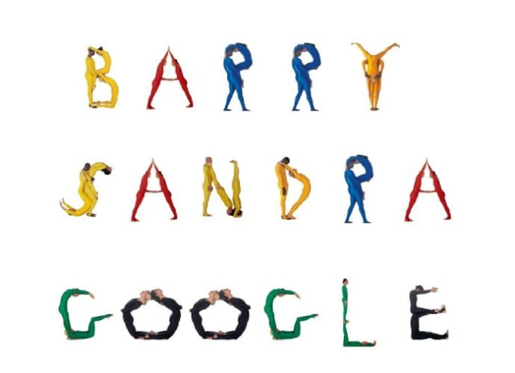
2.
Form the Letter M only with the Bodies of Your Team
3 MinS

Slide 23
3.
Show the Different Stages of self-Isolation With Your Team.
Be CreATIVe!
4 MinS

Slide 24
4. Team Narwhal

Slide 25
How many commits
did we push to master for ratepay Gateway
Notes:
1915

Slide 26
2. Who joined the
Team over time? (1 Person, 1 Point)
(including today)
Notes:
Mpho,Vlad,Chico,Ursula,Sanket,Michael,Michel,Priyanka,Philipp,Johannes, Christoph, Naval, Gautham, Saga

Slide 27

3. Which nationalities have worked
In Team Narwhal? Name the person and Nationality
(1 Nationality, 1Point)
3 min

Slide 28
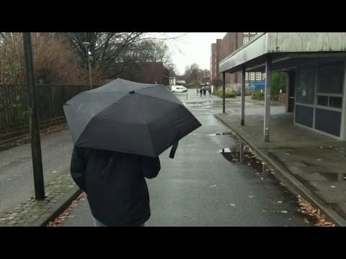
🎶 ❔🎬

Slide 29
5. What Items had the Sleepover guy with him? BONUS Points for the reason this Video exists!
3 min

Slide 30

5 MIN break

