Slide 1
Welcome to the fIrst And Best
TW remote Pub Quiz!

Slide 2

YOUR Lovely Hosts for this Evening

Slide 3
HOW IT WORKS
Random Teams
6 Rounds
10 Minutes per Round
Submit Answers Per Google Form

Slide 4
Test Round
Find A Team Name
Select A Team Captain
Take a nice Team Picture!

Slide 5
1. Random knowledge

Slide 6




qUestion 1: From which country is the hashtag #WhiteWednesday
C: Jemen
A: Spain
B: Saudi Arabia
D: Iran
Notes:
Answer: D
https://www.bustle.com/p/what-is-white-wednesday-iran-women-are-fighting-for-the-freedom-to-dress-how-they-want-7767786

Slide 7
Question 2

Slide 8

qUestion 2
Which particle is Also called the God Particle?
Notes:
Answer: Higgs Boson
https://en.wikipedia.org/wiki/Higgs_boson
https://www.youtube.com/watch?v=-fXAsrZ-ePM (Documentary Particle Fever)
youtube.com/watch?v=edvdzh9Pggg (beyond Higgs Boson)

Slide 9
Question 3

Slide 10
qUestion 3
The Finnish news Broadcast “Nunti Latini” was broadcasted in Latin for how many years?
Why was the show canceled after so many years?
Notes:
Answer: 30 Jahre | too much competition
Source:
The Best Book of 2019 S. 158
https://de.wikipedia.org/wiki/Nuntii_Latini

Slide 11
Question 4

Slide 12
qUestion 4: How much was Stonehenge auctioned off for?
C: £6,600
A: £12,037
D: £1
B: £533,000
Notes:
Answer: C
Source:
https://en.wikipedia.org/wiki/Cecil_Chubb
A man was sent out by his wife to buy garden chairs at an auction and came back with Stonehenge.
The monument remained in private ownership until 1918 when Cecil Chubb, a local man who had purchased Stonehenge from the Atrobus family at an auction three years previously, gave it to the nation.^{[20]} Thereafter, the duty to conserve the monument fell to the state, today a role performed on its behalf by English Heritage.
C Chippindale, Stonehenge Complete, 4th edn (London, 2012), 176.
https://www.english-heritage.org.uk/visit/places/stonehenge/history-and-stories/history/#footnote-20

Slide 13


Slide 14


Question 1: All of these have more germs on their surface than a toilet seat apart from
Light Switch
B. Kitchen sponge
C. Office desk
D. Mobile phone
2 MinS

Slide 15
Question 2

Slide 16
Question 2: Which of the following does bacteria need to assist it to grow and multiply?
C: Food
A: Water
B: Warm temperature
D: All of the above
1 Min

Slide 17
Question 3

Slide 18
Question 3: The smallest form of bacteria is called:
vibrio
B. cocci
C. bacilli
D. spirilla
1 Min

Slide 19
Question 4

Slide 20
Question 4: The number of germs on your hands is comparable to the number of:
Grains of sand on beach
B. Trees in a forest
C. Cars in a parking lot
1 Min

Slide 21
Question 5

Slide 22
Question 5: Arrange the correct year of the following pandemics in the following order: 1. Smallpox, 2. Black Death(Bubonic Plague) 3. Spanish Flu 4. COVID-19
A: 1520, 1347, 1918, 2020
B: 1918, 1520, 1347, 2020
C: 1347,1520,1918, 2020
2 MinS

Slide 23
3. INTERACTIVE

Slide 24
You Need:
Paper
Pencil
A Little Bit OF Space

Slide 25
1.
DrAw ONE Cat Together With Your Team
3 MinS

Slide 26
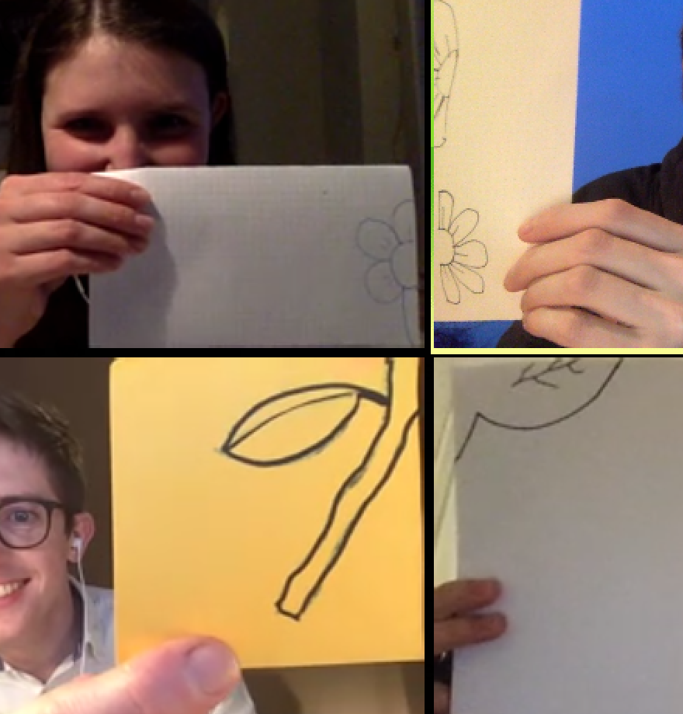
1.
DrAw ONE Cat Together With Your Team
3 MinS

Slide 27
2.
Form the Letter M only with the Bodies of Your Team
3 MinS

Slide 28
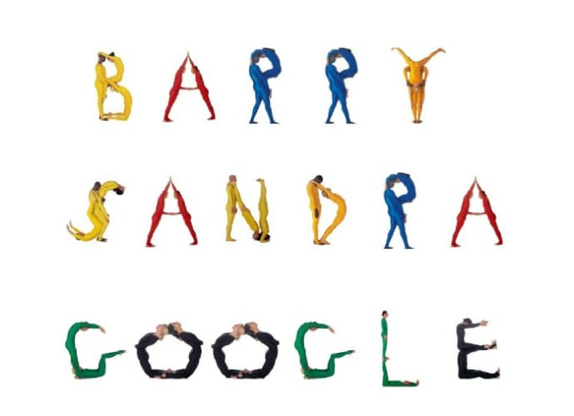
2.
Form the Letter M only with the Bodies of Your Team
3 MinS

Slide 29
3.
Show the Different Stages of self-Isolation With Your Team.
Be CreATIVe!
4 MinS

Slide 30

3.
Show the Different Stages of self-Isolation With Your Team.
Be CreATIVe!
4 MinS

Slide 31
4. THoUGHtWoRKs

Slide 32

How Many QA’s Do
Currently have their
working office
in Germany?
(excluding TWU trainers)
1 min

Slide 33
2. How Many Days has
martin Fowler
been with Thoughtworks?
(including today)
1 min

Slide 34
3. Name the ThoughtWorkers
who gave the talks !
(see your Google Form)
Extra Points If you can Name An event per Talk where it was Held!
2 min

Slide 35

4. Name One
Technique and
one Tool that
is in Adopt of
Vol.21 of the
tech radar!
2 min
Extra Points: What
was the Fastest a
Blip has moved
from Assess to Adopt? Which one was it?

Slide 36

🎶 ❔🎬

Slide 37
5. Write Down the
Names, Roles & Home Offices of as many TWers as you recognized!
2 min

Slide 38
5. HISTORY

Slide 39
qUestion 1: Which disease was eradicated by the first global vaccination campaign?
A: Dracunculiasis
B: Hookworm
C: Smallpox
D: Poliomyelitis
Notes:
Answer C
https://en.wikipedia.org/wiki/Eradication_of_infectious_diseases#Smallpox
https://www.zeitsprung.fm/podcast/zs224/
https://en.wikipedia.org/wiki/Balmis_Expedition

Slide 40
Question 2

Slide 41
qUestion 2
How many heads are in the grave of the famous musician Joseph Haydn?
Notes:
Answer: 2
https://www.zeitsprung.fm/podcast/zs217/
https://en.wikipedia.org/wiki/Haydn%27s_head
https://en.wikipedia.org/wiki/Joseph_Haydn

Slide 42
Question 3

Slide 43
qUestion 3: How Was the usage of baby Incubators established in the U.S of America as a standard in hospitals?
B: Through a blackmailing
scheme by
Organised crime
A: Through an Ad Campaign
C: Through a
human zoo of babies in incubators
D: Through the adoption of
the law 219g
Notes:
Answer C
https://www.history.com/news/baby-incubators-boardwalk-sideshows-medical-marvels
https://www.zeitsprung.fm/podcast/zs188/
Between 6000 and 7000 babies were rescued through this

Slide 44
Question 4

Slide 45
qUestion 4: What was the yellow fleet?
A: The Allied battle
fleet in the pacific
ocean
B: The first fleet transporting Bananas
to Rome
C: The Pirate
Fleet of Ching Shih
D: fifteen ships that were trapped in the Suez Canal
Notes:
Answer D
https://en.wikipedia.org/wiki/Yellow_Fleet

Slide 46
Question 5

Slide 47
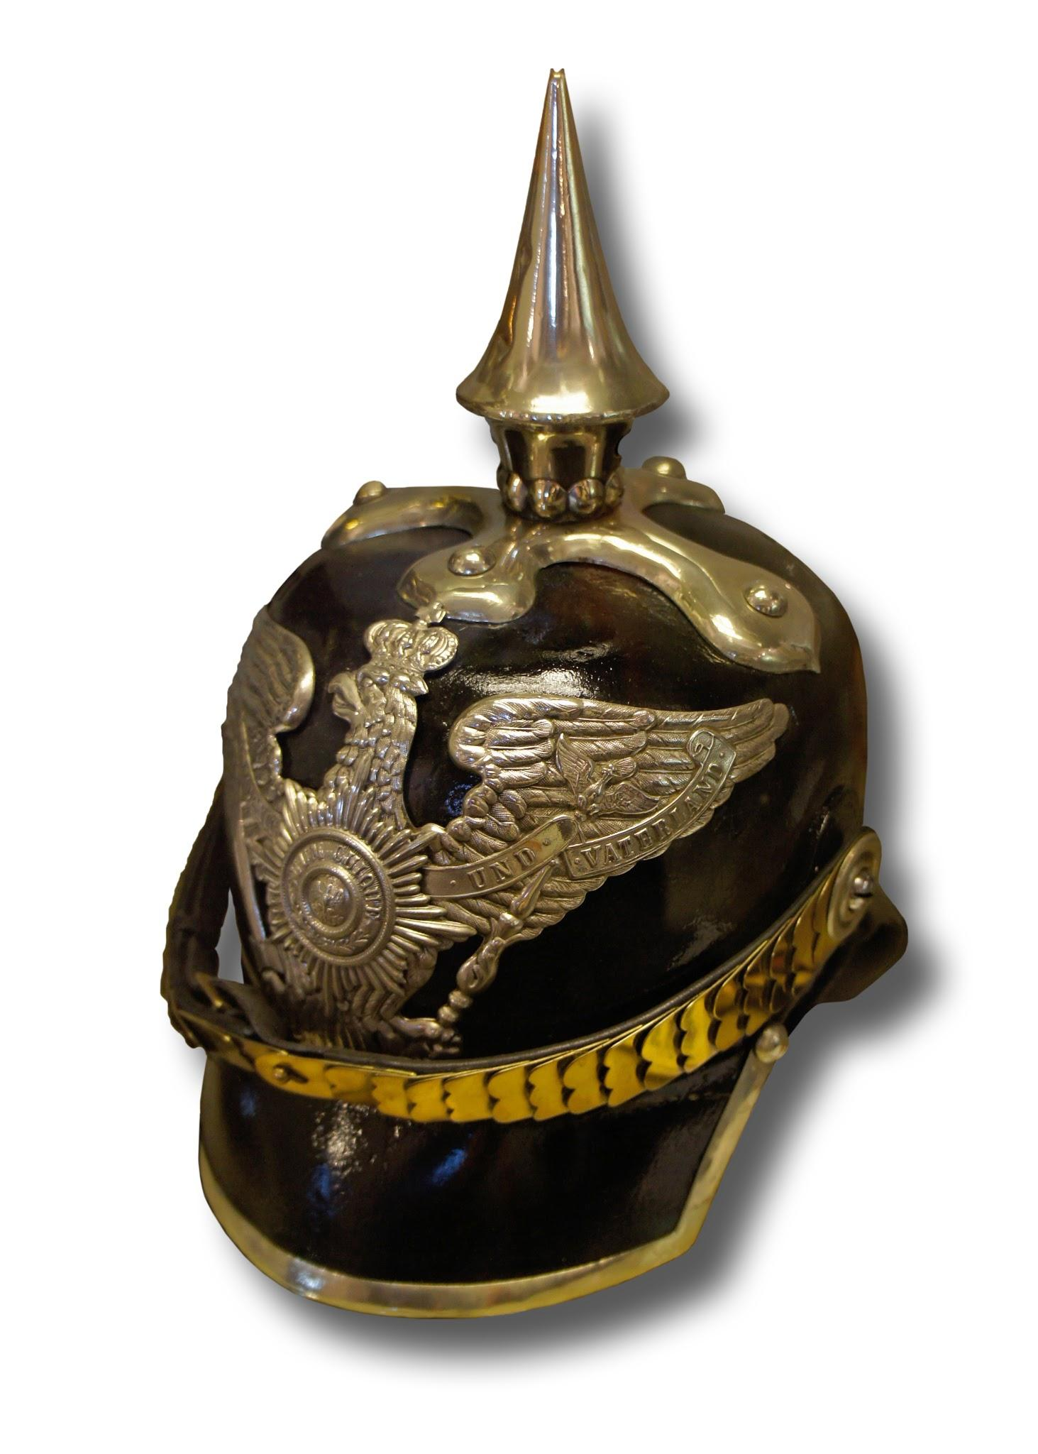
qUestion 5: what is this for?
Notes:
It is to defend against an attack of swords
https://en.wikipedia.org/wiki/Pickelhaube

Slide 48
6. MUSIC

Slide 49
What is the Title of this song?
Animal Music
Robot Music
B
a
Human Music
Plant Music
C
D
1 min
Notes:
Play: Human Music - Rick and Morty on Spotify
https://open.spotify.com/track/5PvH3rnQPUdugtGCxWwDod?si=UnPJGVZXQX-HWPrcqV2Z8Q

Slide 50

..Featured in Rick & Morty, S01 / E04
Human Music

Slide 51
Question 2

Slide 52
Listen Carefully, The upcoming song will end abruptly!
What is the name of the Band? (1 P.)
What are The Next 5 words? (1 p.)
1 min
Notes:
https://open.spotify.com/track/4fXGWiVhlOLdhwRDP6pIFG?si=zba69oCkSzOUuHKt22chLQ

Slide 53



… is not good for me
Band: Fools garden

Slide 54
Question 3

Slide 55
who "picks up the rice in the church where a wedding has been"?
Eleanor Rigby
Bryonie Pritchard
B
a
C
D
Rosalie Crutchley
Antonia Pinfield
1 min

Slide 56
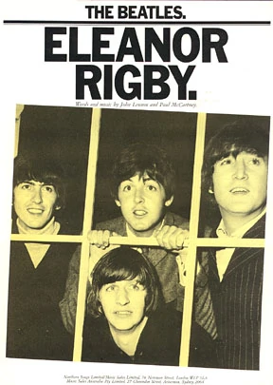
… by “the beatles”
Eleanor Rigby
Notes:
https://open.spotify.com/track/6EOKwO6WaLal58MSsi6U4W?si=GxRZR3xWRqWtvYMprbxPXg

Slide 57
Question 4

Slide 58
This is part of a classical music piece. Who is the composer?
Good night, good night,
Shit in your bed and make it burst

Slide 59
This is a part of a musical piece. Who is the composer?
Beethoven
Mozart
a
B
Chopin
Bach
C
D
1 min

Slide 60
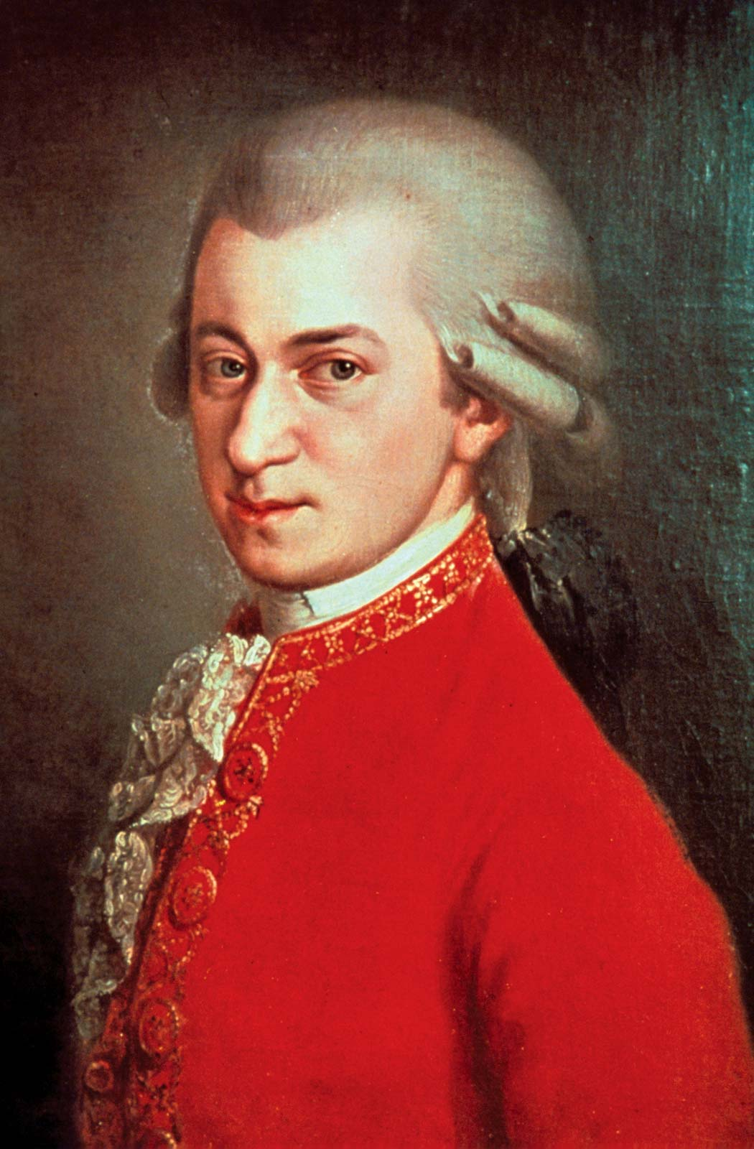
Bona nox - W.A. Mozart
… gute Nacht, gute Nacht,
scheiß ins Bett daß' kracht;
Mozart
Notes:
https://open.spotify.com/track/75xCjkrj4pkPoXmGanOTyd?si=L86om8HUTR22w3k7ebpA_g

Slide 61
Question 5

Slide 62
Listen Carefully, The upcoming song will end abruptly! What are The Next 5 words?
1 min
Notes:
https://open.spotify.com/track/1Je1IMUlBXcx1Fz0WE7oPT?si=HtEzACXVSu64rl3YA9ShoA

Slide 63

Wannabe - SPice girls
...If you wanna get with me

Slide 64

5 MIN break

