Slide 1
Now comes the answers
To the
TW remote Pub Quiz!

Slide 2
1. Random knowledge

Slide 3

qUestion 1: From which country is the hashtag #WhiteWednesday
D: IRAN
Notes:
Answer: D
https://www.bustle.com/p/what-is-white-wednesday-iran-women-are-fighting-for-the-freedom-to-dress-how-they-want-7767786

Slide 4

qUestion 2: Which particle is Also called the God Particle?
Notes:
Answer: Higgs Boson
https://en.wikipedia.org/wiki/Higgs_boson
https://www.youtube.com/watch?v=-fXAsrZ-ePM (Documentary Particle Fever)
youtube.com/watch?v=edvdzh9Pggg (beyond Higgs Boson)

Slide 5
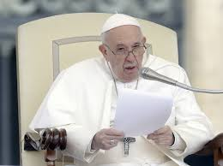
qUestion 3: The Finnish news Broadcast “Nunti Latini” was broadcasted in Latin for how many years?
Why was the show canceled after so many years?
30 yearS
2. Too much competition
3.The vatican
Notes:
Answer: 30 Jahre | too much competition
Source:
The Best Book of 2019 S. 158
https://de.wikipedia.org/wiki/Nuntii_Latini

Slide 6
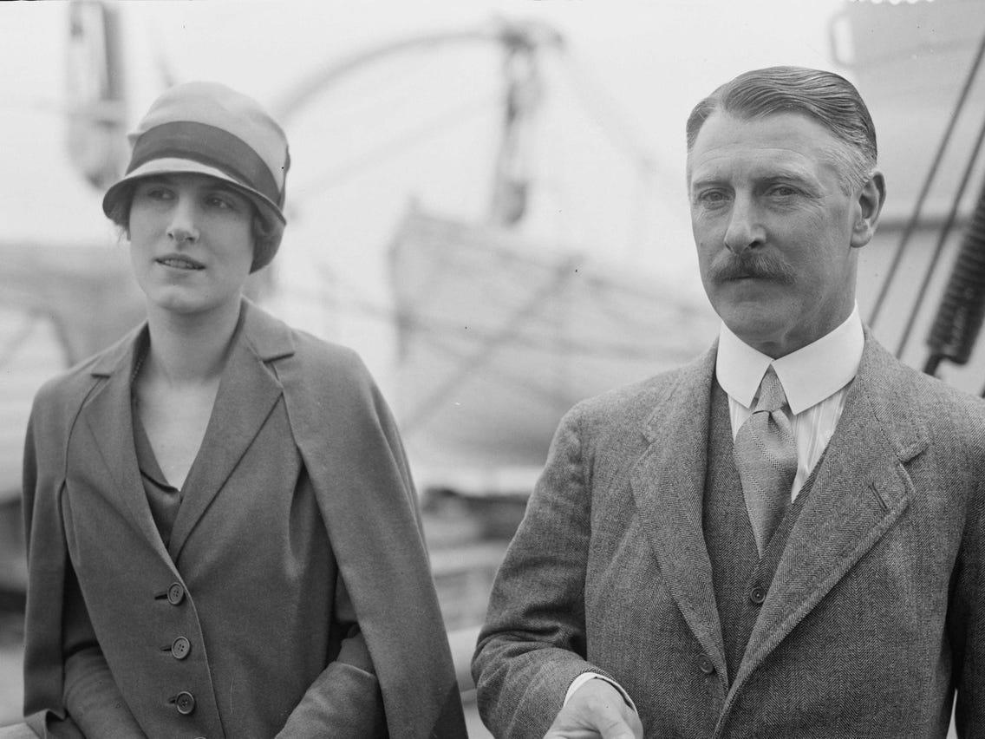

qUestion 4: How much was Stonehenge auctioned off for?
C: £6,600
Mary Bella Alice Finch
Cecil chubb
Notes:
Answer: C
Source:
https://en.wikipedia.org/wiki/Cecil_Chubb
A man was sent out by his wife to buy garden chairs at an auction and came back with Stonehenge.
The monument remained in private ownership until 1918 when Cecil Chubb, a local man who had purchased Stonehenge from the Atrobus family at an auction three years previously, gave it to the nation.^{[20]} Thereafter, the duty to conserve the monument fell to the state, today a role performed on its behalf by English Heritage.
C Chippindale, Stonehenge Complete, 4th edn (London, 2012), 176.
https://www.english-heritage.org.uk/visit/places/stonehenge/history-and-stories/history/#footnote-20

Slide 7


Slide 8


Question 1: All of these have more germs on their surface than a toilet seat apart from
Light Switch
Toilet seat: 295 bacteria per square inch
Light switch: 217 bacteria per square inch

Slide 9

Question 2: Which of the following does bacteria need to assist it to grow and multiply?
All of the above

Slide 10

Question 3: The smallest form of bacteria is called?
B. cocci

Slide 11
Question 4: The number of germs on your hands is comparable to the number of:
Grains of sand on beach

Slide 12
Question 5: Arrange the correct year of the following pandemics in the following order: 1. Smallpox, 2. The Third plague 3. Black Death(Bubonic Plague) 4. Spanish Flu
A: 1520, 1855, 1347, 1918

Slide 13
3. INTERACTIVE

Slide 14
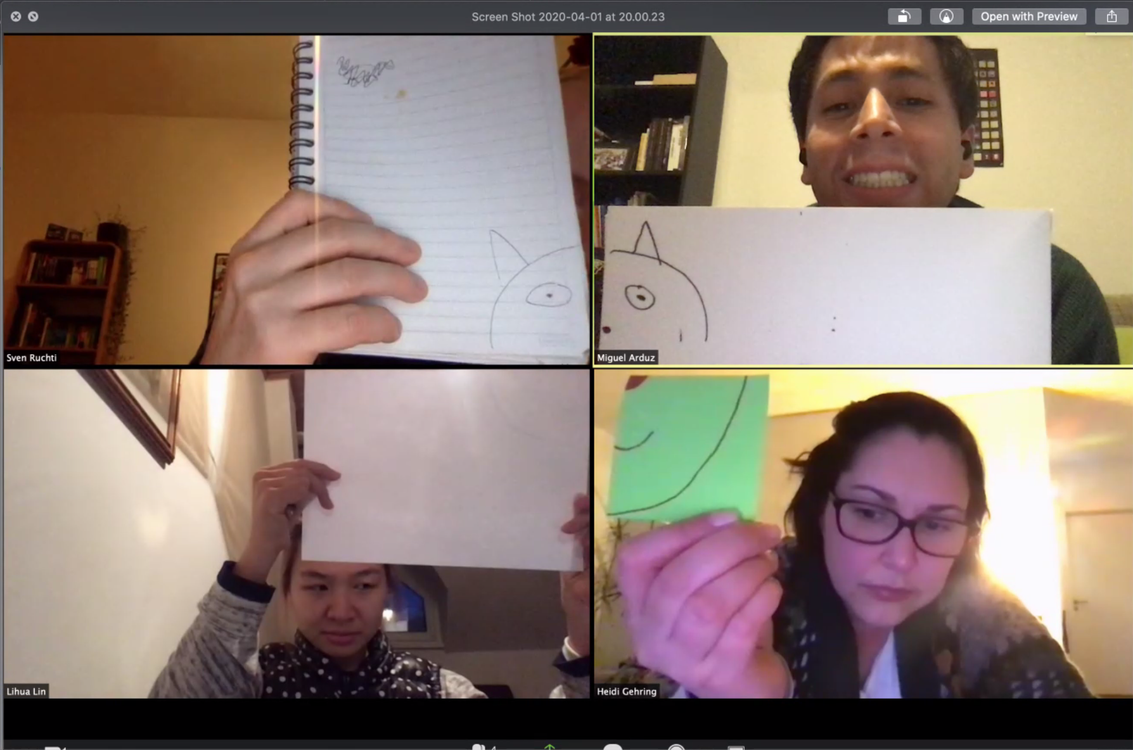
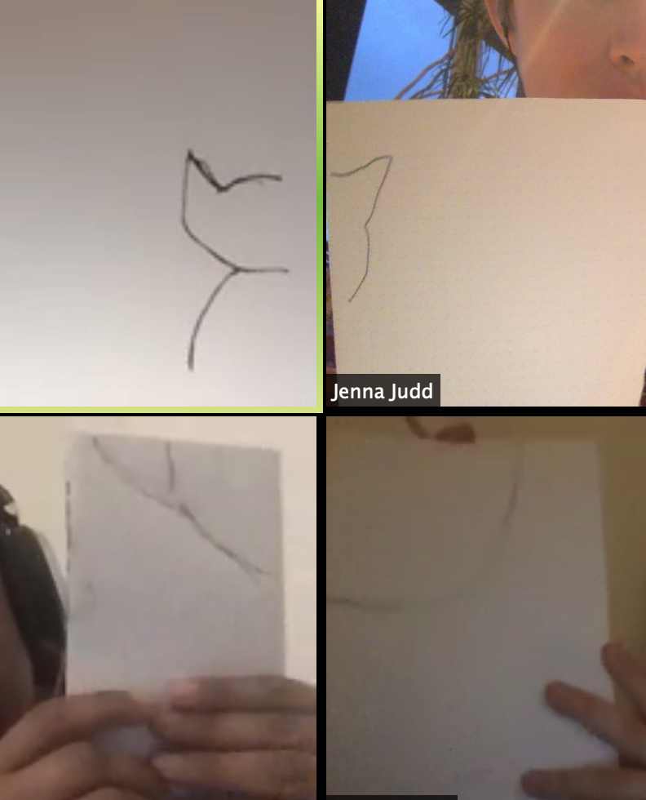
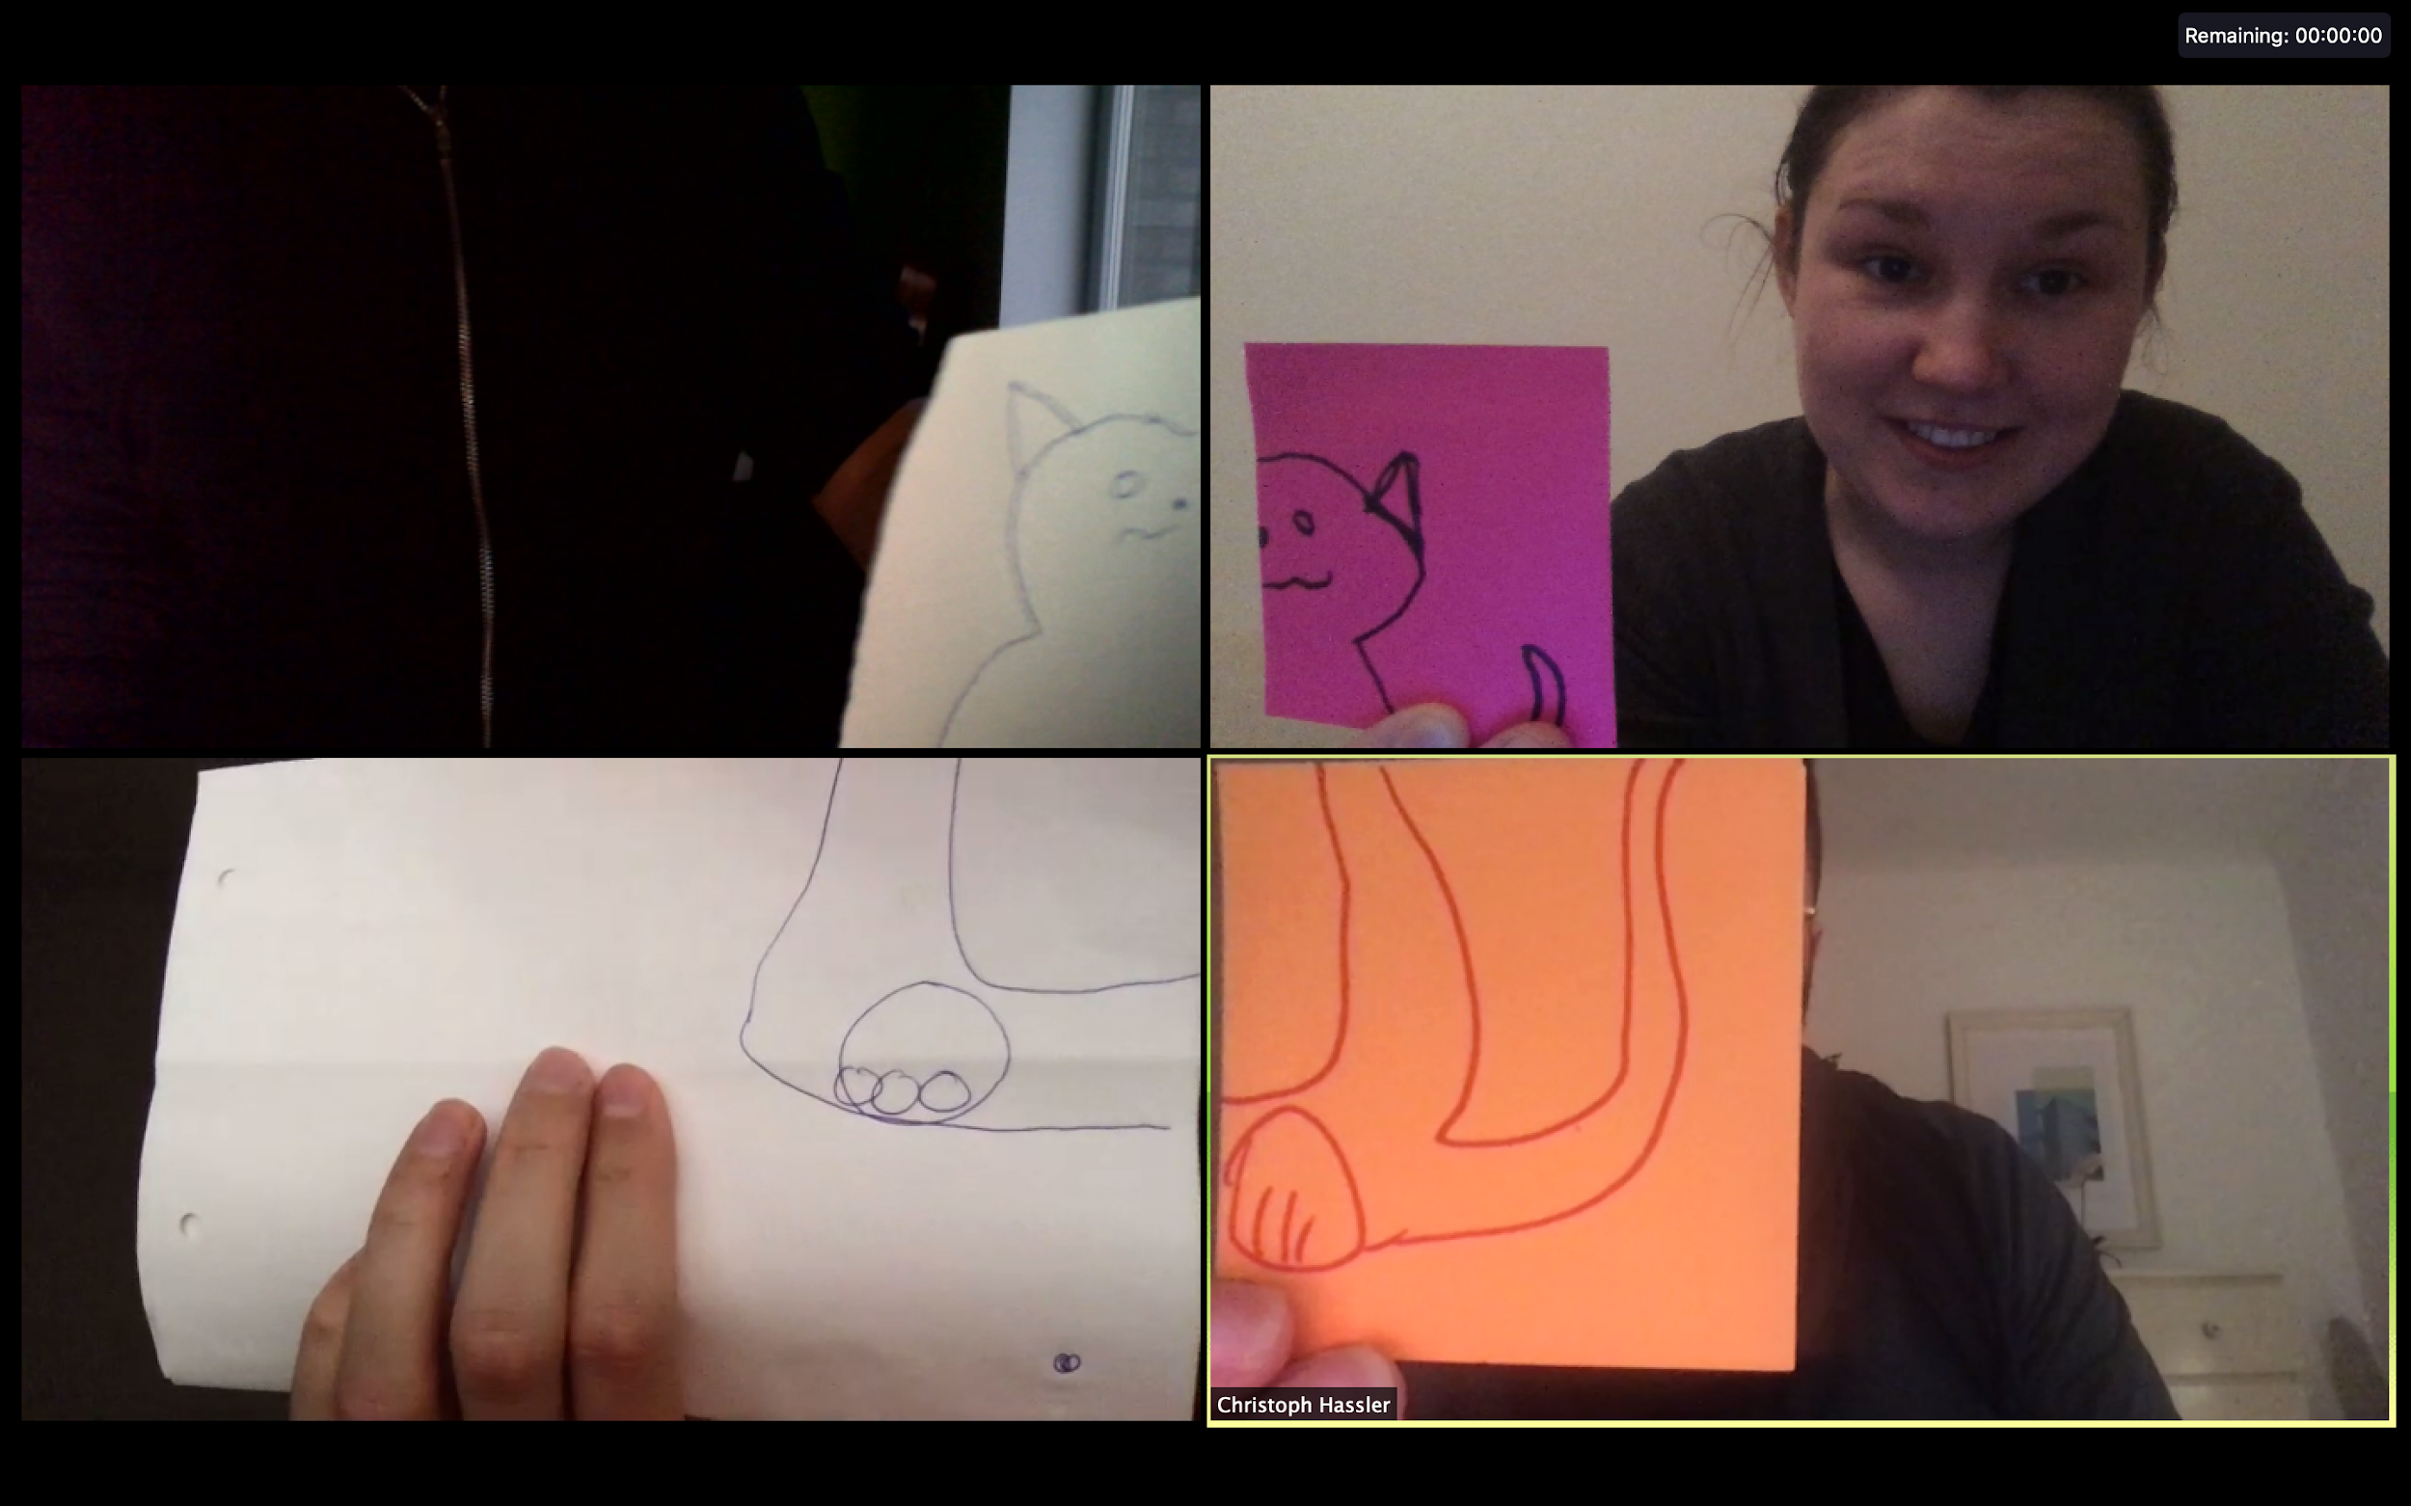
YOUr SUBMISSIONS:

Slide 15
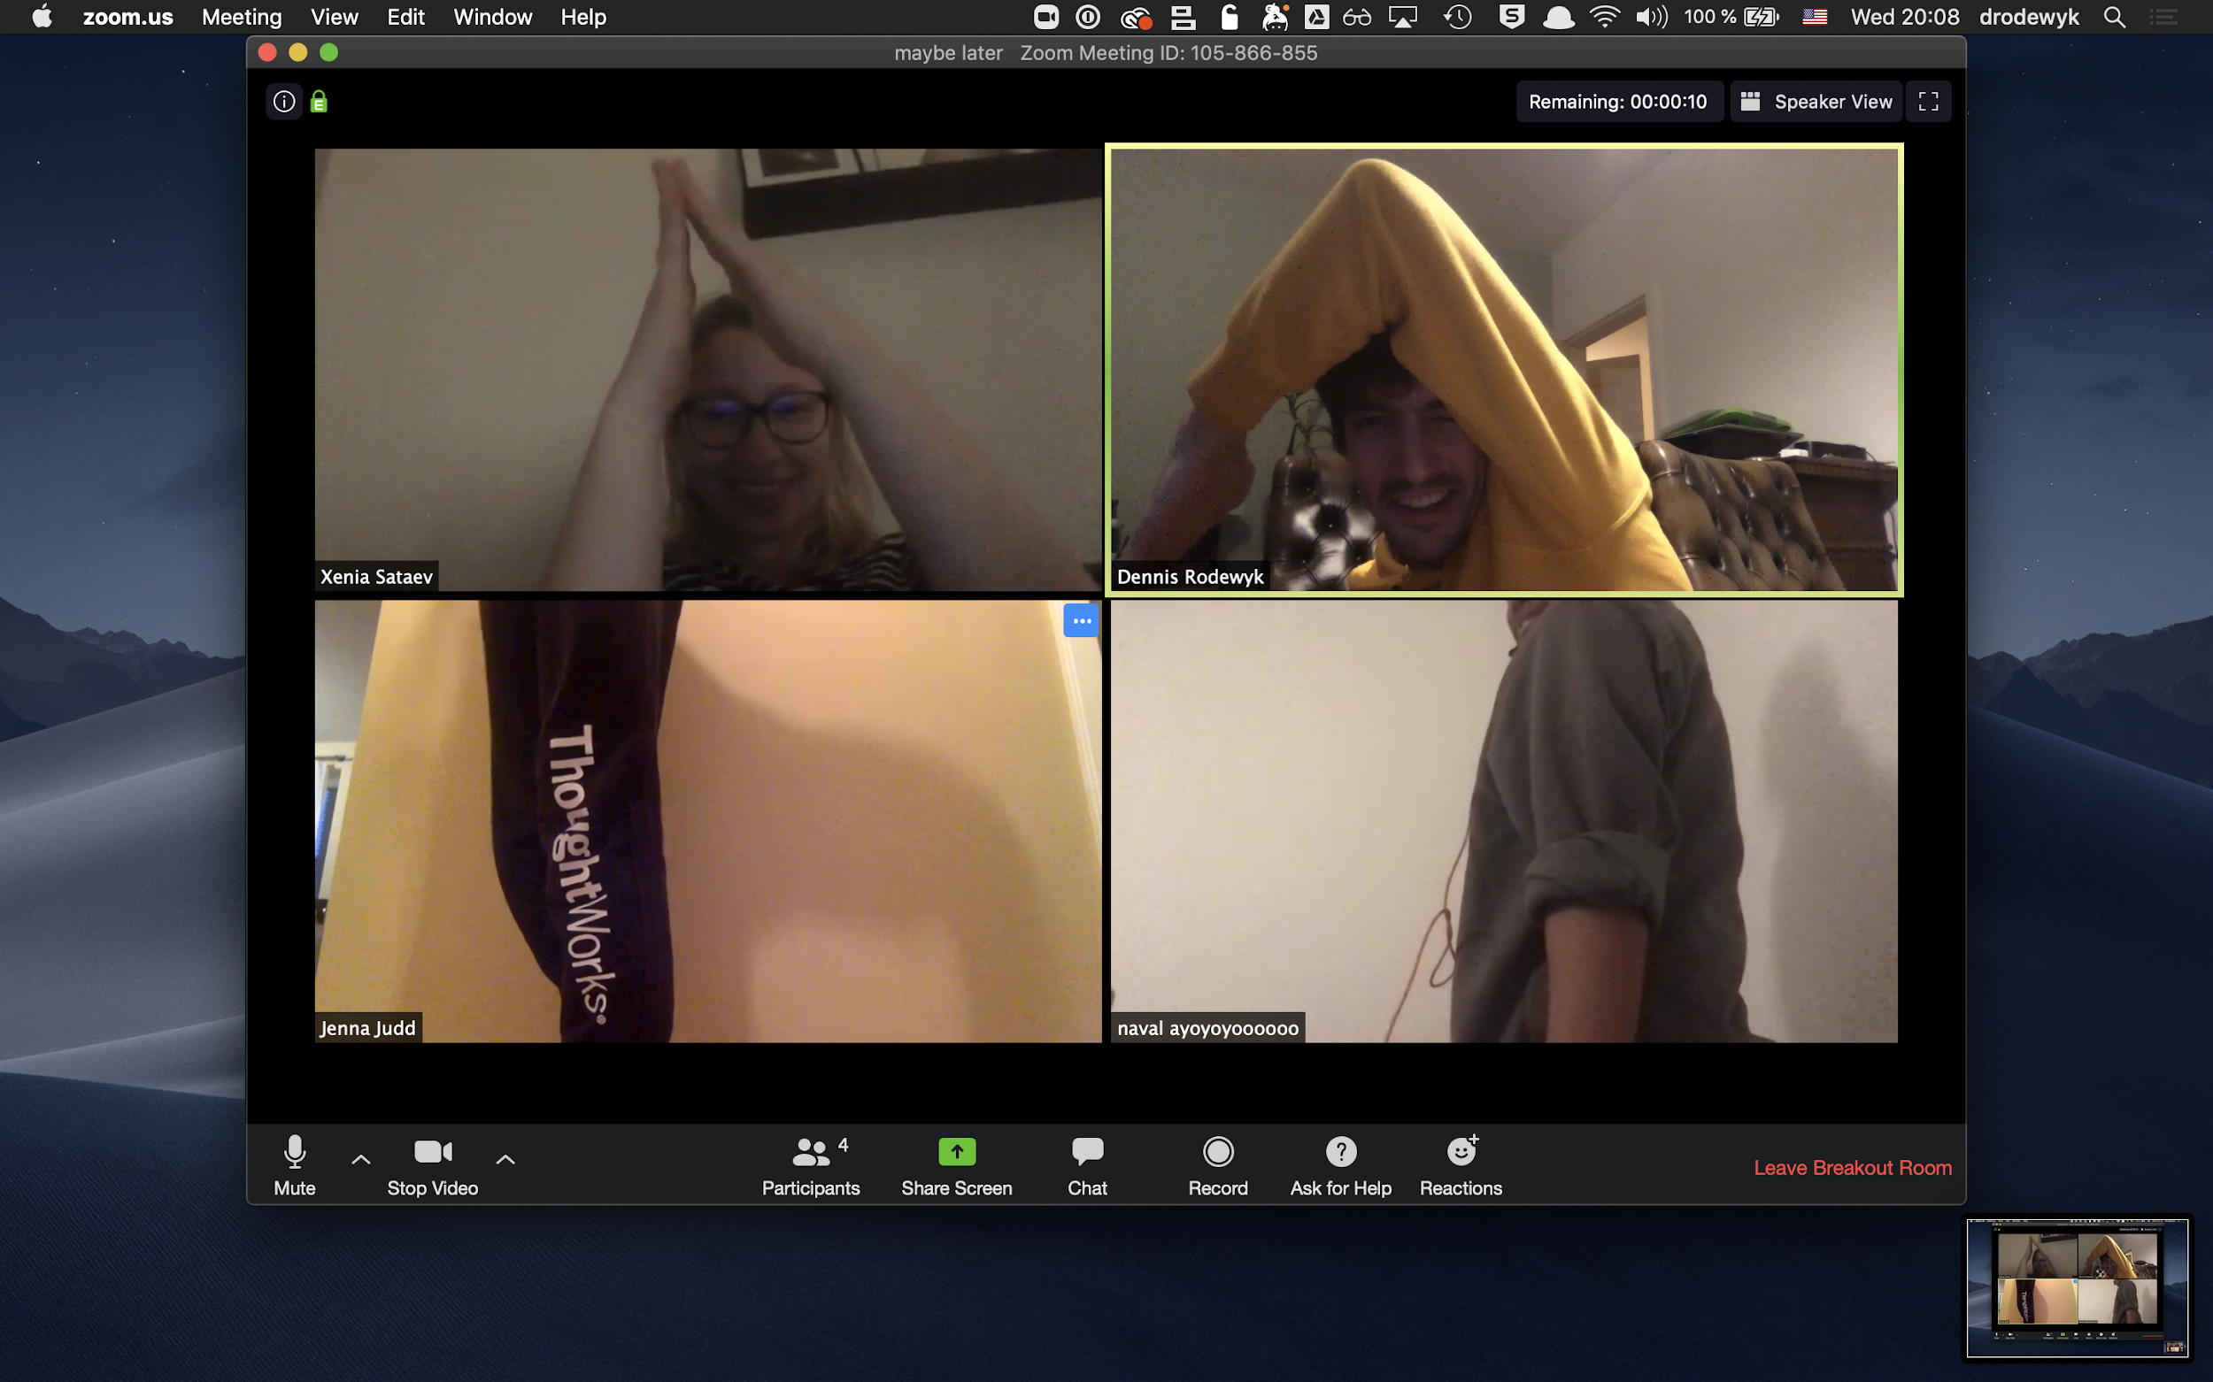
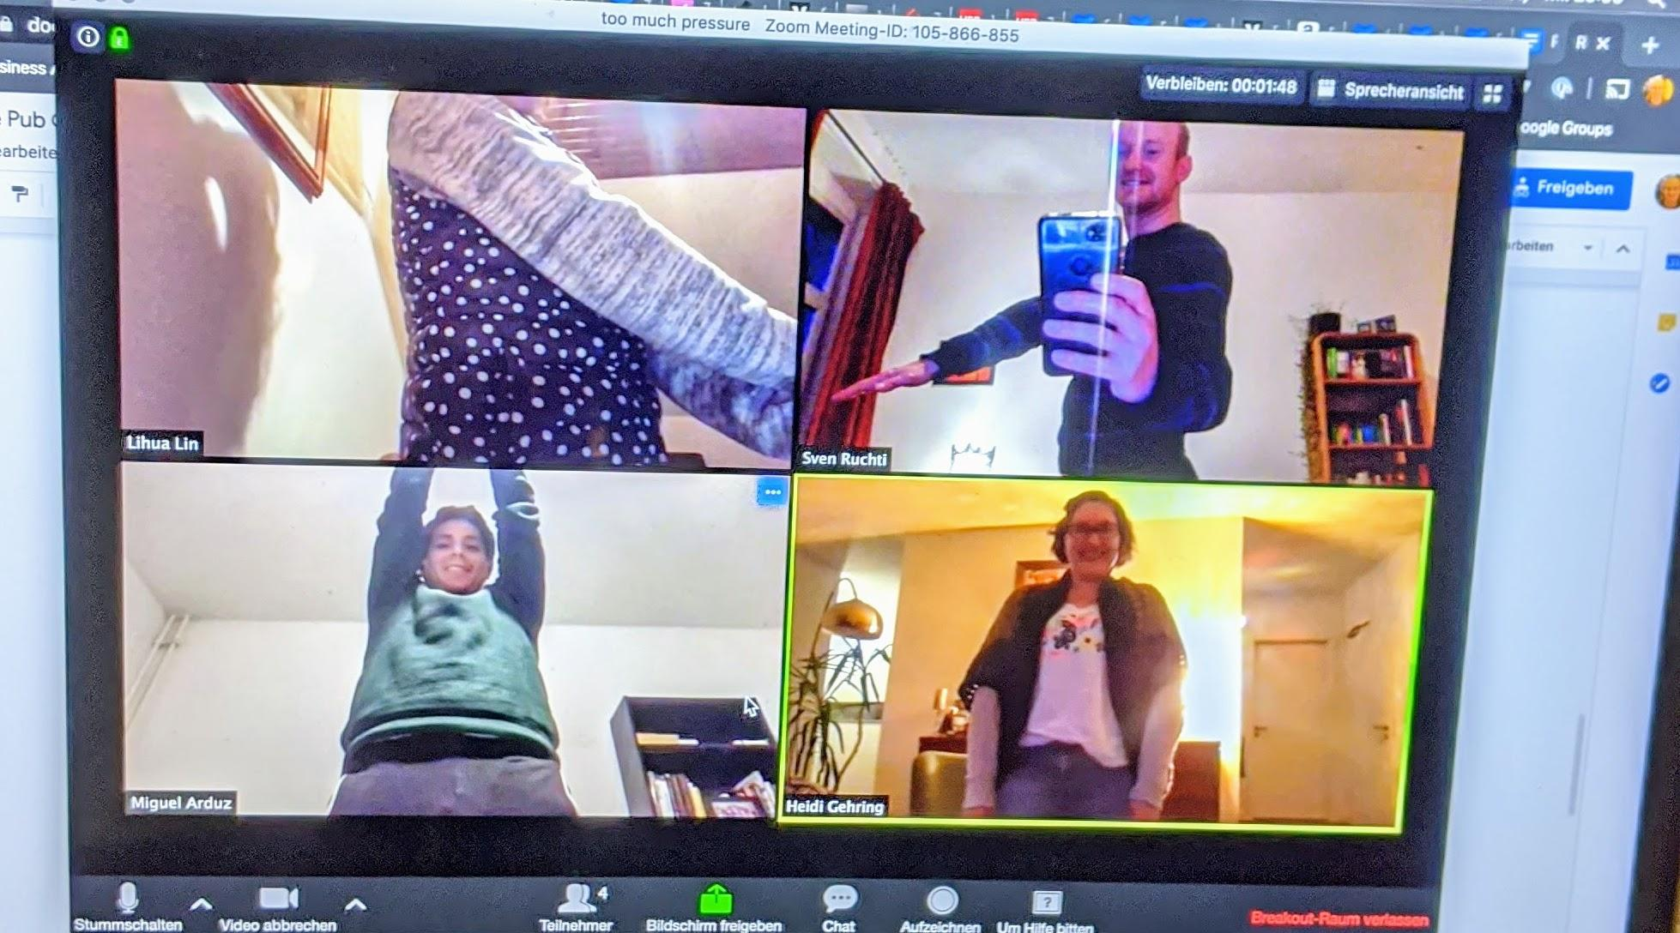
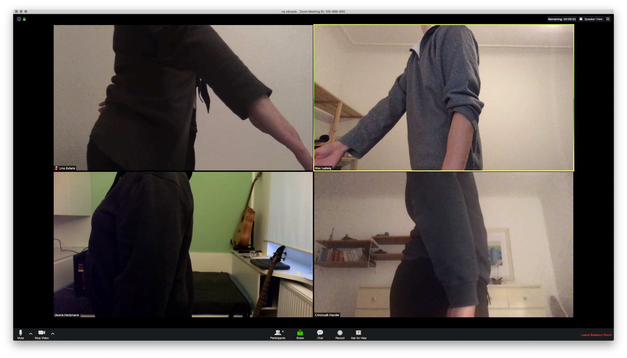
2. YOUr SUBMISSIONS:

Slide 16
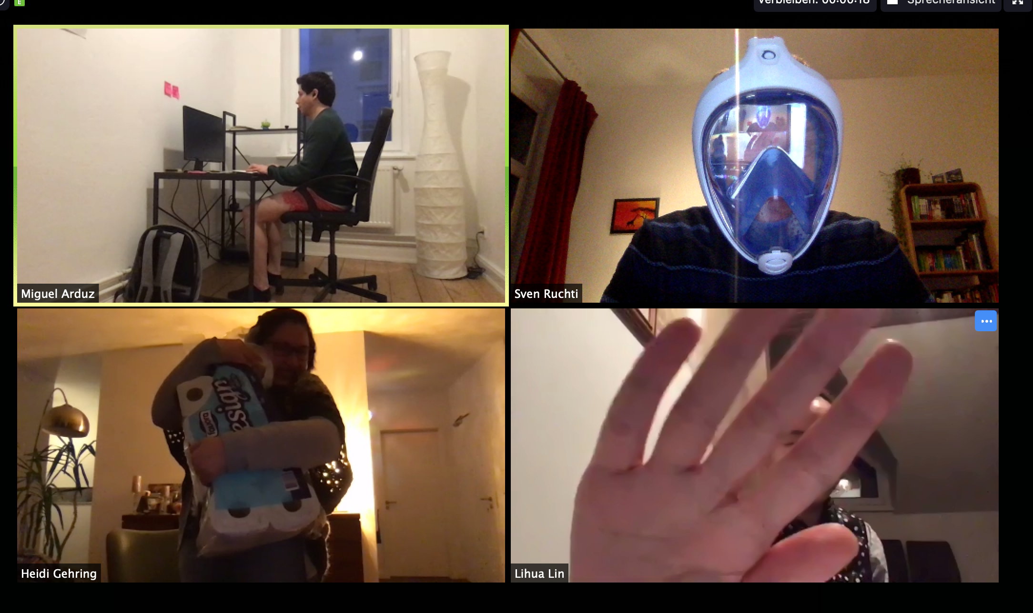
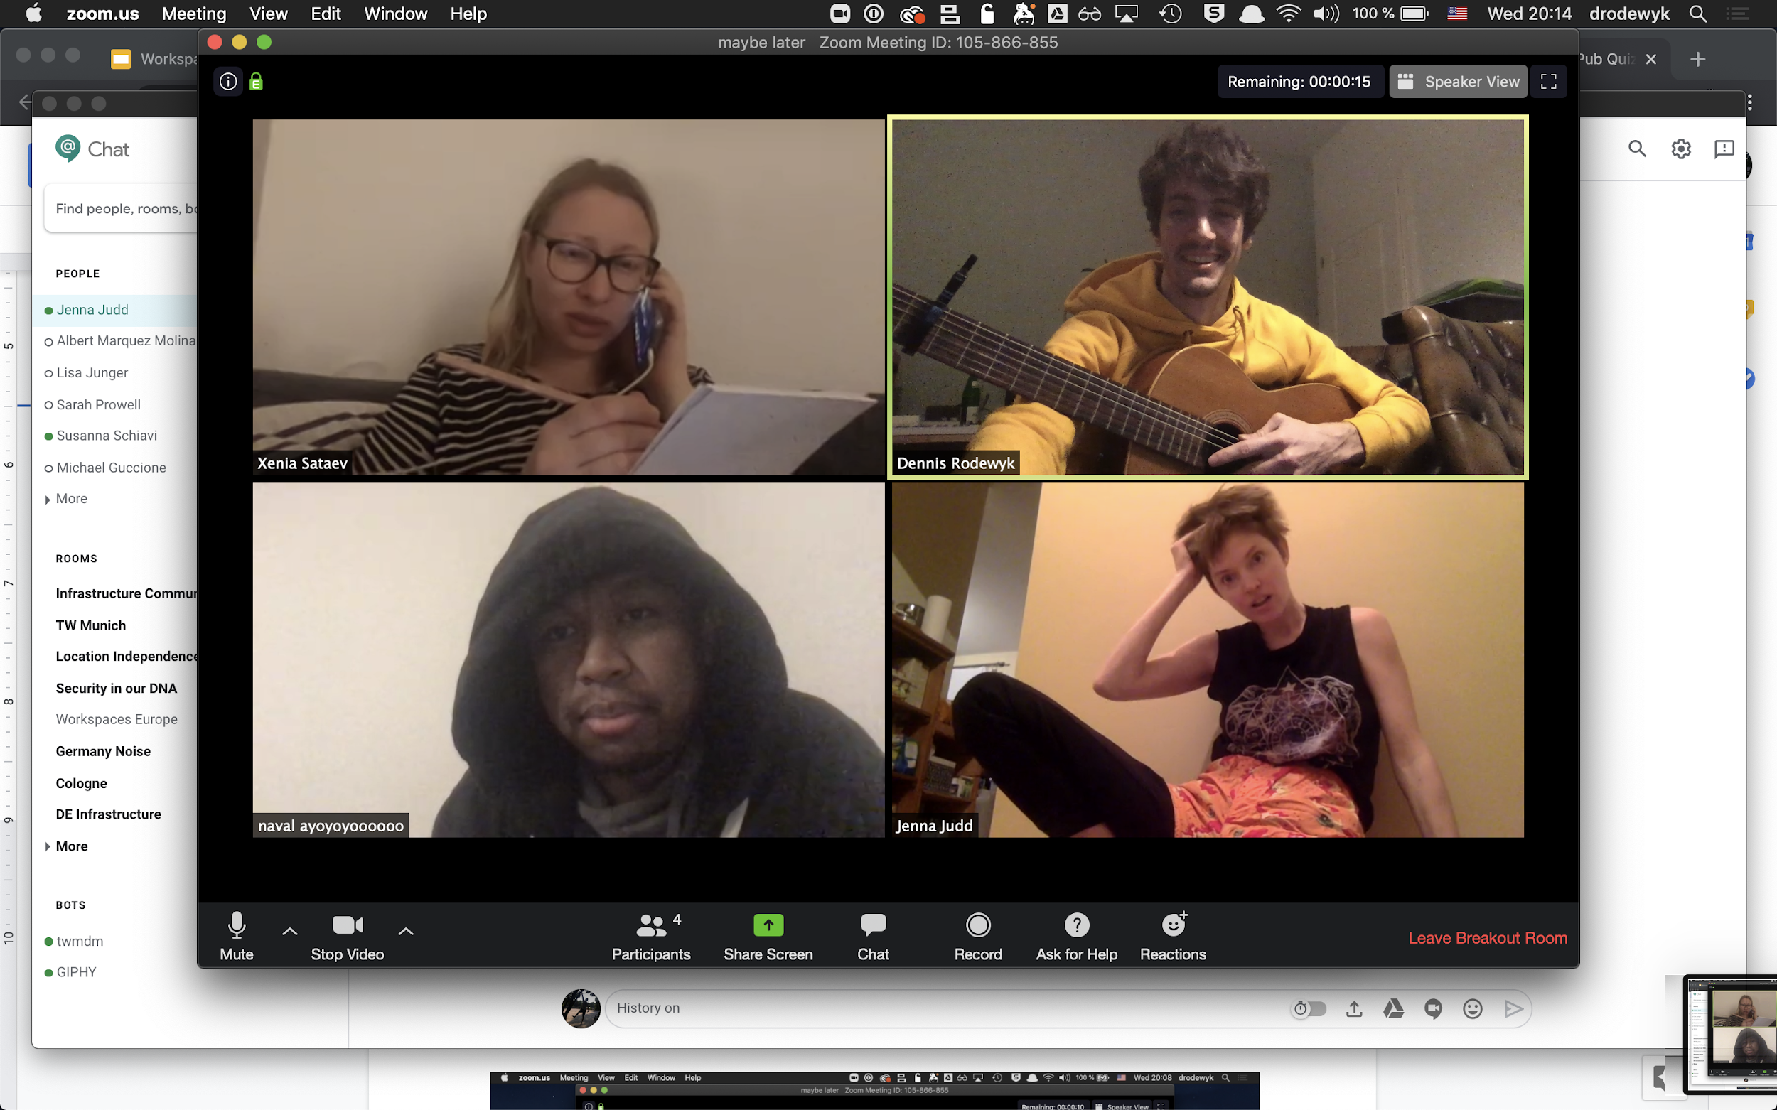
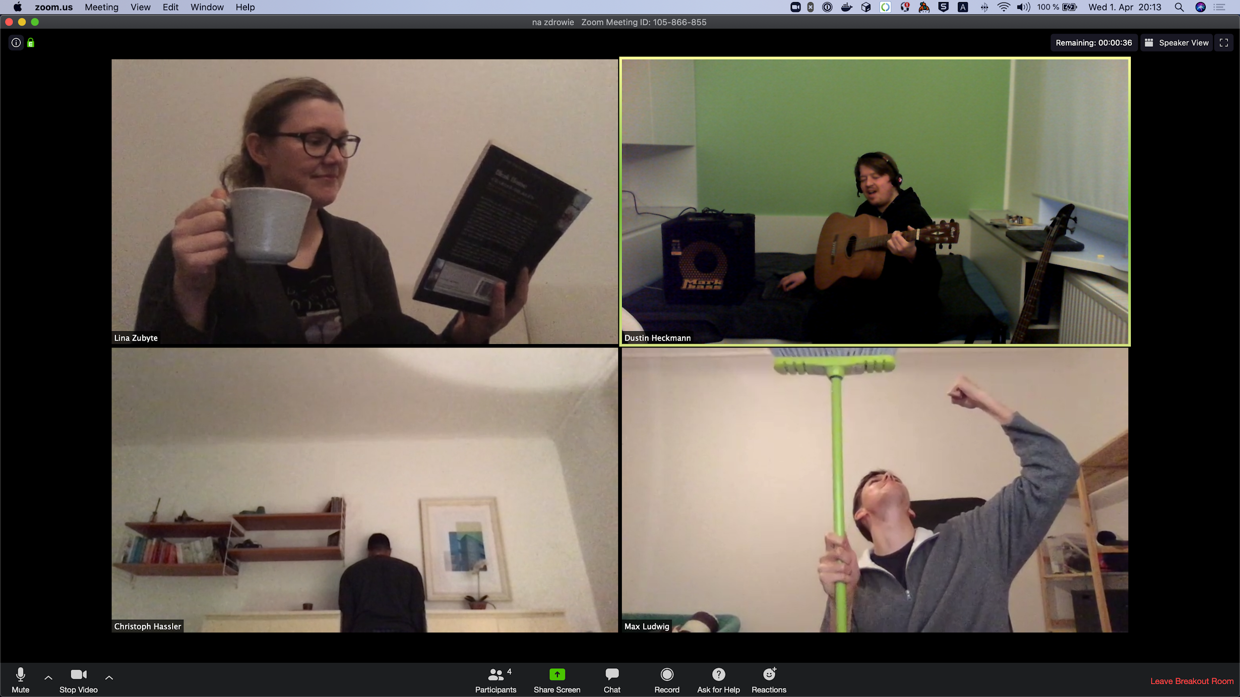
3. YOUr SUBMISSIONS:

Slide 17
4. THoUGHtWoRKs

Slide 18
How Many QAs Do Currently have their working office in Germany?

Slide 19
How Many QAs Do Currently have their working office in Germany?
19

Slide 20

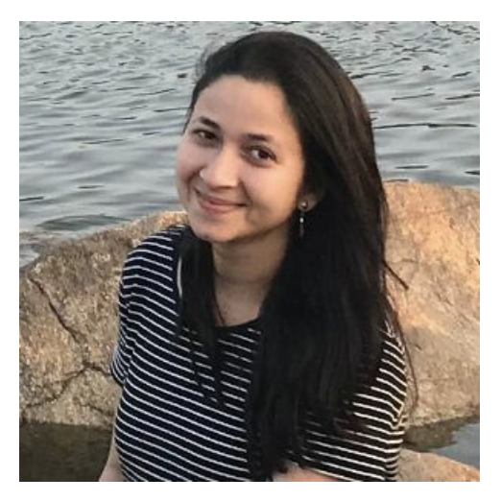

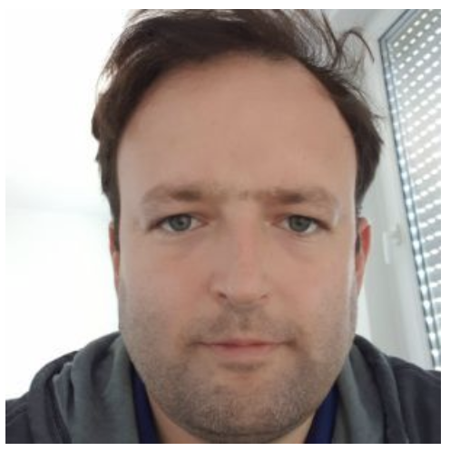

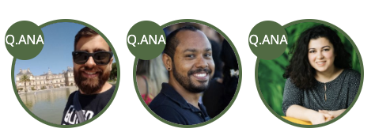
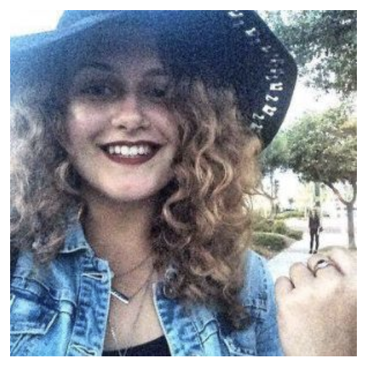
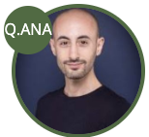
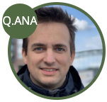
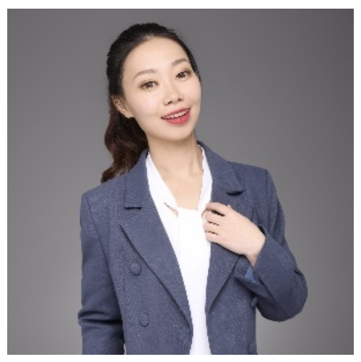
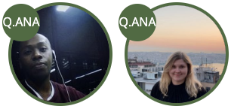

How Many QAs Do Currently have their working office in Germany?
19

Slide 21
2. How Many Days Has Martin Fowler been with TW?

Slide 22
2. How Many Days Has Martin Fowler been with TW?
7332 Days

Slide 23


3. Name the ThoughtWorkers who gave the talks:
“To pair or
not to pair”
“Chaos engineering, When should you release the monkeys?”
“This is kinda cool, but can I serve it from my raspberry pi?”
Notes:
Chaos Engineering, when should you release the monkeys?
--- Steve Upton (XConf 2019 Munich, Brown Bag 2019)
This is kinda cool, but can I serve it from my Raspberry Pi?
--- Gesa Stupperich (XConf 2019 Munich)
To pair or not to pair: Pair Programming
--- Birgitta Bockeler (XConf 2018 North America, Martin Fowler in Germany 2018, Codemotion 2019 Berlin)

Slide 24
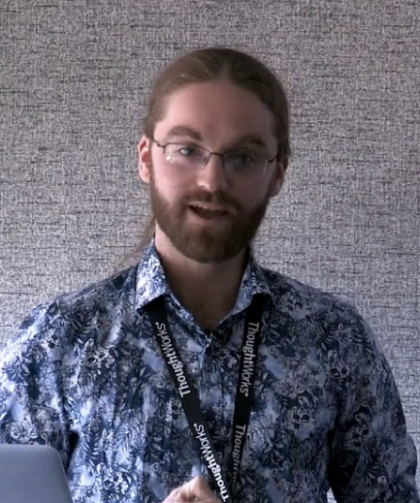
3. Name the ThoughtWorkers who gave the talks:
“To pair or
not to pair”
“Chaos engineering, When should you release the monkeys?”
Steve Upton
“This is kinda cool, but can I serve it from my raspberry pi?”
Notes:
Chaos Engineering, when should you release the monkeys?
--- Steve Upton (XConf 2019 Munich, Brown Bag 2019)
This is kinda cool, but can I serve it from my Raspberry Pi?
--- Gesa Stupperich (XConf 2019 Munich)
To pair or not to pair: Pair Programming
--- Birgitta Bockeler (XConf 2018 North America, Martin Fowler in Germany 2018, Codemotion 2019 Berlin)

Slide 25
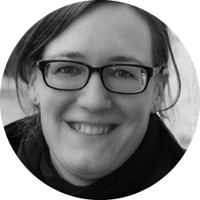
3. Name the ThoughtWorkers who gave the talks:
“To pair or
not to pair”
Birgitta Boeckeler
“Chaos engineering, When should you release the monkeys?”
Steve Upton
“This is kinda cool, but can I serve it from my raspberry pi?”
Notes:
Chaos Engineering, when should you release the monkeys?
--- Steve Upton (XConf 2019 Munich, Brown Bag 2019)
This is kinda cool, but can I serve it from my Raspberry Pi?
--- Gesa Stupperich (XConf 2019 Munich)
To pair or not to pair: Pair Programming
--- Birgitta Bockeler (XConf 2018 North America, Martin Fowler in Germany 2018, Codemotion 2019 Berlin)

Slide 26
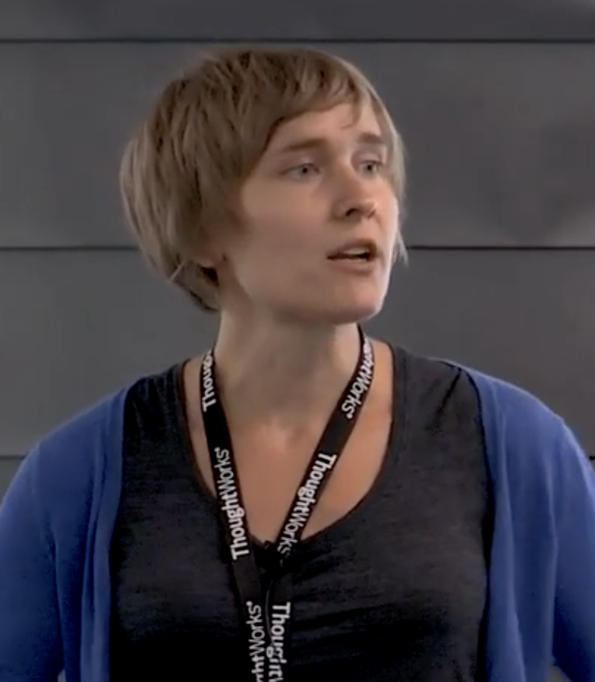
3. Name the ThoughtWorkers who gave the talks:
“To pair or
not to pair”
Birgitta Boeckeler
“Chaos engineering, When should you release the monkeys?”
Steve Upton
“This is kinda cool, but can I serve it from my raspberry pi?”
Gesa Stupperich
Notes:
Chaos Engineering, when should you release the monkeys?
--- Steve Upton (XConf 2019 Munich, Brown Bag 2019)
This is kinda cool, but can I serve it from my Raspberry Pi?
--- Gesa Stupperich (XConf 2019 Munich)
To pair or not to pair: Pair Programming
--- Birgitta Bockeler (XConf 2018 North America, Martin Fowler in Germany 2018, Codemotion 2019 Berlin)

Slide 27
4. Name One Technique and one Tool that are in Adopt in vol.21 of the tech radar!

Slide 28
4. Name One Technique and one Tool that are in Adopt in vol.21 of the tech radar!
Techniques
Container Security Scanning
Data Integrity At the origin
Micro Frontends
Pipelines for Infrastructure as code
Run cost as architecture fitness function
Testing using real device

Slide 29
4. Name One Technique and one Tool that are in Adopt in vol.21 of the tech radar!
Tools
Commitizen
EsLint
React Styleguidist
Techniques
Container Security Scanning
Data Integrity At the origin
Micro Frontends
Pipelines for Infrastructure as code
Run cost as architecture fitness function
Testing using real device

Slide 30

4. Name One Technique and one Tool that are in Adopt in vol.21 of the tech radar!
Tools
Commitizen
EsLint
React Styleguidist
Techniques
Container Security Scanning
Data Integrity At the origin
Micro Frontends
Pipelines for Infrastructure as code
Run cost as architecture fitness function
Testing using real device

Slide 31

5. Write Down the
Names, Roles & Home Offices of as many TWers as you recognized!
Notes:
1st shot:
Sriram Viswanathan, Dev, Gurgaon India (exited)
Gabriel Gavaso, BA, Berlin
Martin Weisath, CP, Hamburg (exited)
2nd shot:
Dennis Rowdewyk, Techops, Hamburg
Jenna Judd, Community Manager, Hamburg
Simon Weiler, Dev, Hamburg
Klaus Hartel, Dev, Berlin
3rd:
Peter Buhrmann, Managing Director, Hamburg
4th
Nikolas Buckstegen, Marketing, Cologne
Isabel Scholz, Marketing, Hamburg
Lisa Weyerstrass, Marketing, Cologne
Aileen Pistorius, Head of Marketing, Cologne
5th
Kelsey Mok, Dev, Munich
6th
Hermann Vocke, Dev/Staffing, Hamburg (exited)
7th
Sebastian Thiel, Dev, Hamburg/Xi’an (PT to China)
Viktoriya Georgieva, Dev, Munich
8th
Pranathi Birudugadda, QA, Berlin (LTA in San Francisco)
Inger Dickson, BA/PM, Dallas/Cologne
?
Bruna Chagas, QA, Recife (exited)
9th
?
Shashikanth Gadgay, Dev, Hyderabad
Sriram Viswanathan, Dev, Gurgaon India (exited)
Lina Zubyte, QA, Berlin
10th
? , Working Student Marketing, Cologne
Casper Ntaraaki, QA, Cologne
11th
Susanne Schell, People Operations, Hamburg
Helga Plinke, PM/OP, Hamburg
Laura Hammelmann, People/Global Mobility, Hamburg
12th
Dennis Rowdewyk, Techops, Hamburg
Katja Uhle, Office Manager, Berlin
Tina Boye, Office Manager, Cologne
Jeremy Tai Abbett, Domain Specialist, Hamburg (exited)
Casper Ntaraaki, QA, Cologne
Johannes Thoenes, Dev, Hamburg (exited)
Birgitta Boeckeler, Dev, Berlin
?
Ferdinand Beyer, Dev, Munich
13th
Christoph Hassler, XD, Hamburg
14th
Dino Frese, Head of Demand, Cologne (exited)
Hermann Vocke, Dev/Staffing, Hamburg (exited)
Moritz Heiber, Infrastructure, Cologne
Birgitta Boeckeler, Dev, Berlin
Michael Fait, Dev, Hamburg
Helga Plinke, PM/OP, Hamburg
Nina Wainwright, PM, Cologne
15th
Kirsten Völkl, CP, Cologne
?
?
?
16th
?
?
?
17th
Sebastian Thiel, Dev, Hamburg/Xi’an (PT to China)
Johannes Thoenes, Dev, Hamburg (exited)
Dania Azayzeh, Dev, Hamburg
Martha Rohte, Dev, Hamburg
Alma Zertuche, BA, Berling
Bernd Gunther, CP, Hamburg
Lisa Kugler, Dev, Hamburg (exited)
Christoph Burgmer, Dev, Hamburg
Wolf Schlegel, Dev, Hamburg
Robert Kotlowski, QA, Hamburg
Birgitta Boeckeler, Dev, Berlin
Huan Wang, Head of Business Unit, Xi’an/Munich
18th
?
?
19th
Dino Frese, Head of Demand, Cologne (exited)
Barbara Phipps, Head of Operations, New York
20th
Wolf Schlegel, Dev, Hamburg

Slide 32
5. Write Down the
Names, Roles & Home Offices of as many TWers as you recognized!
Kelsey Mok, Dev, Munich
Hermann Vocke, Dev/Staffing, Hamburg (exited)
Sebastian Thiel, Dev, Hamburg/Xi’an (PT to China)
Viktoriya Georgieva, Dev, Munich
Pranathi Birudugadda, QA, Berlin (LTA in San Francisco)
Inger Dickson, BA/PM, Dallas/Cologne
Shashikanth Gadgay, Dev, Hyderabad
Lina Zubyte, QA, Berlin
Casper Ntaraaki, QA, Cologne
Susanne Schell, People Operations, Hamburg
Notes:
1st shot:
Sriram Viswanathan, Dev, Gurgaon India (exited)
Gabriel Gavaso, BA, Berlin
Martin Weisath, CP, Hamburg (exited)
2nd shot:
Dennis Rowdewyk, Techops, Hamburg
Jenna Judd, Community Manager, Hamburg
Simon Weiler, Dev, Hamburg
Klaus Hartel, Dev, Berlin
3rd:
Peter Buhrmann, Managing Director, Hamburg
4th
Nikolas Buckstegen, Marketing, Cologne
Isabel Scholz, Marketing, Hamburg
Lisa Weyerstrass, Marketing, Cologne
Aileen Pistorius, Head of Marketing, Cologne
5th
Kelsey Mok, Dev, Munich
6th
Hermann Vocke, Dev/Staffing, Hamburg (exited)
7th
Sebastian Thiel, Dev, Hamburg/Xi’an (PT to China)
Viktoriya Georgieva, Dev, Munich
8th
Pranathi Birudugadda, QA, Berlin (LTA in San Francisco)
Inger Dickson, BA/PM, Dallas/Cologne
?
Bruna Chagas, QA, Recife (exited)
9th
?
Shashikanth Gadgay, Dev, Hyderabad
Sriram Viswanathan, Dev, Gurgaon India (exited)
Lina Zubyte, QA, Berlin
10th
? , Working Student Marketing, Cologne
Casper Ntaraaki, QA, Cologne
11th
Susanne Schell, People Operations, Hamburg
Helga Plinke, PM/OP, Hamburg
Laura Hammelmann, People/Global Mobility, Hamburg
12th
Dennis Rowdewyk, Techops, Hamburg
Katja Uhle, Office Manager, Berlin
Tina Boye, Office Manager, Cologne
Jeremy Tai Abbett, Domain Specialist, Hamburg (exited)
Casper Ntaraaki, QA, Cologne
Johannes Thoenes, Dev, Hamburg (exited)
Birgitta Boeckeler, Dev, Berlin
?
Ferdinand Beyer, Dev, Munich
13th
Christoph Hassler, XD, Hamburg
14th
Dino Frese, Head of Demand, Cologne (exited)
Hermann Vocke, Dev/Staffing, Hamburg (exited)
Moritz Heiber, Infrastructure, Cologne
Birgitta Boeckeler, Dev, Berlin
Michael Fait, Dev, Hamburg
Helga Plinke, PM/OP, Hamburg
Nina Wainwright, PM, Cologne
15th
Kirsten Völkl, CP, Cologne
?
?
?
16th
?
?
?
17th
Sebastian Thiel, Dev, Hamburg/Xi’an (PT to China)
Johannes Thoenes, Dev, Hamburg (exited)
Dania Azayzeh, Dev, Hamburg
Martha Rohte, Dev, Hamburg
Alma Zertuche, BA, Berling
Bernd Gunther, CP, Hamburg
Lisa Kugler, Dev, Hamburg (exited)
Christoph Burgmer, Dev, Hamburg
Wolf Schlegel, Dev, Hamburg
Robert Kotlowski, QA, Hamburg
Birgitta Boeckeler, Dev, Berlin
Huan Wang, Head of Business Unit, Xi’an/Munich
18th
?
?
19th
Dino Frese, Head of Demand, Cologne (exited)
Barbara Phipps, Head of Operations, New York
20th
Wolf Schlegel, Dev, Hamburg

Slide 33

Moritz Heiber, Infrastructure, Cologne
Michael Fait, Dev, Hamburg
Nina Wainwright, PM, Cologne
Dino Frese, Head of Demand, Cologne (exited)
Kirsten Völkl, CP, Cologne
Barbara Phipps, Head of Operations, New York
Dania Azayzeh, Dev, Hamburg
Martha Rohte, Dev, Hamburg
Alma Zertuche, BA, Berling
Bernd Gunther, CP, Hamburg
Lisa Kugler, Dev, Hamburg (exited)
Christoph Burgmer, Dev, Hamburg
Wolf Schlegel, Dev, Hamburg
Robert Kotlowski, QA, Hamburg
Huan Wang, Head of Bu, Xi’an/Munich
5. Write Down the
Names, Roles & Home Offices of as many TWers as you recognized!
Kelsey Mok, Dev, Munich
Hermann Vocke, Dev/Staffing, Hamburg (exited)
Sebastian Thiel, Dev, Hamburg/Xi’an (PT to China)
Viktoriya Georgieva, Dev, Munich
Pranathi Birudugadda, QA, Berlin (LTA in San Francisco)
Inger Dickson, BA/PM, Dallas/Cologne
Shashikanth Gadgay, Dev, Hyderabad
Lina Zubyte, QA, Berlin
Casper Ntaraaki, QA, Cologne
Susanne Schell, People Operations, Hamburg
Notes:
1st shot:
Sriram Viswanathan, Dev, Gurgaon India (exited)
Gabriel Gavaso, BA, Berlin
Martin Weisath, CP, Hamburg (exited)
2nd shot:
Dennis Rowdewyk, Techops, Hamburg
Jenna Judd, Community Manager, Hamburg
Simon Weiler, Dev, Hamburg
Klaus Hartel, Dev, Berlin
3rd:
Peter Buhrmann, Managing Director, Hamburg
4th
Nikolas Buckstegen, Marketing, Cologne
Isabel Scholz, Marketing, Hamburg
Lisa Weyerstrass, Marketing, Cologne
Aileen Pistorius, Head of Marketing, Cologne
5th
Kelsey Mok, Dev, Munich
6th
Hermann Vocke, Dev/Staffing, Hamburg (exited)
7th
Sebastian Thiel, Dev, Hamburg/Xi’an (PT to China)
Viktoriya Georgieva, Dev, Munich
8th
Pranathi Birudugadda, QA, Berlin (LTA in San Francisco)
Inger Dickson, BA/PM, Dallas/Cologne
?
Bruna Chagas, QA, Recife (exited)
9th
?
Shashikanth Gadgay, Dev, Hyderabad
Sriram Viswanathan, Dev, Gurgaon India (exited)
Lina Zubyte, QA, Berlin
10th
? , Working Student Marketing, Cologne
Casper Ntaraaki, QA, Cologne
11th
Susanne Schell, People Operations, Hamburg
Helga Plinke, PM/OP, Hamburg
Laura Hammelmann, People/Global Mobility, Hamburg
12th
Dennis Rowdewyk, Techops, Hamburg
Katja Uhle, Office Manager, Berlin
Tina Boye, Office Manager, Cologne
Jeremy Tai Abbett, Domain Specialist, Hamburg (exited)
Casper Ntaraaki, QA, Cologne
Johannes Thoenes, Dev, Hamburg (exited)
Birgitta Boeckeler, Dev, Berlin
?
Ferdinand Beyer, Dev, Munich
13th
Christoph Hassler, XD, Hamburg
14th
Dino Frese, Head of Demand, Cologne (exited)
Hermann Vocke, Dev/Staffing, Hamburg (exited)
Moritz Heiber, Infrastructure, Cologne
Birgitta Boeckeler, Dev, Berlin
Michael Fait, Dev, Hamburg
Helga Plinke, PM/OP, Hamburg
Nina Wainwright, PM, Cologne
15th
Kirsten Völkl, CP, Cologne
?
?
?
16th
?
?
?
17th
Sebastian Thiel, Dev, Hamburg/Xi’an (PT to China)
Johannes Thoenes, Dev, Hamburg (exited)
Dania Azayzeh, Dev, Hamburg
Martha Rohte, Dev, Hamburg
Alma Zertuche, BA, Berling
Bernd Gunther, CP, Hamburg
Lisa Kugler, Dev, Hamburg (exited)
Christoph Burgmer, Dev, Hamburg
Wolf Schlegel, Dev, Hamburg
Robert Kotlowski, QA, Hamburg
Birgitta Boeckeler, Dev, Berlin
Huan Wang, Head of Business Unit, Xi’an/Munich
18th
?
?
19th
Dino Frese, Head of Demand, Cologne (exited)
Barbara Phipps, Head of Operations, New York
20th
Wolf Schlegel, Dev, Hamburg

Slide 34
Moritz Heiber, Infrastructure, Cologne
Michael Fait, Dev, Hamburg
Nina Wainwright, PM, Cologne
Dino Frese, Head of Demand, Cologne (exited)
Kirsten Völkl, CP, Cologne
Barbara Phipps, Head of Operations, New York
Dania Azayzeh, Dev, Hamburg
Martha Rohte, Dev, Hamburg
Alma Zertuche, BA, Berling
Bernd Gunther, CP, Hamburg
Lisa Kugler, Dev, Hamburg (exited)
Christoph Burgmer, Dev, Hamburg
Wolf Schlegel, Dev, Hamburg
Robert Kotlowski, QA, Hamburg
Huan Wang, Head of Bu, Xi’an/Munich
5. Write Down the
Names, Roles & Home Offices of as many TWers as you recognized!
Kelsey Mok, Dev, Munich
Hermann Vocke, Dev/Staffing, Hamburg (exited)
Sebastian Thiel, Dev, Hamburg/Xi’an (PT to China)
Viktoriya Georgieva, Dev, Munich
Pranathi Birudugadda, QA, Berlin (LTA in San Francisco)
Inger Dickson, BA/PM, Dallas/Cologne
Shashikanth Gadgay, Dev, Hyderabad
Lina Zubyte, QA, Berlin
Casper Ntaraaki, QA, Cologne
Susanne Schell, People Operations, Hamburg
Helga Plinke, PM/OP, Hamburg
Laura Hammelmann, People/Global Mobility, Hamburg
Katja Uhle, Office Manager, Berlin
Tina Boye, Office Manager, Cologne
Jeremy Tai Abbett, Domain Specialist, Hamburg (exited)
Johannes Thoenes, Dev, Hamburg (exited)
Birgitta Boeckeler, Dev, Berlin
Ferdinand Beyer, Dev, Munich
Christoph Hassler, XD, Hamburg
Notes:
1st shot:
Sriram Viswanathan, Dev, Gurgaon India (exited)
Gabriel Gavaso, BA, Berlin
Martin Weisath, CP, Hamburg (exited)
2nd shot:
Dennis Rowdewyk, Techops, Hamburg
Jenna Judd, Community Manager, Hamburg
Simon Weiler, Dev, Hamburg
Klaus Hartel, Dev, Berlin
3rd:
Peter Buhrmann, Managing Director, Hamburg
4th
Nikolas Buckstegen, Marketing, Cologne
Isabel Scholz, Marketing, Hamburg
Lisa Weyerstrass, Marketing, Cologne
Aileen Pistorius, Head of Marketing, Cologne
5th
Kelsey Mok, Dev, Munich
6th
Hermann Vocke, Dev/Staffing, Hamburg (exited)
7th
Sebastian Thiel, Dev, Hamburg/Xi’an (PT to China)
Viktoriya Georgieva, Dev, Munich
8th
Pranathi Birudugadda, QA, Berlin (LTA in San Francisco)
Inger Dickson, BA/PM, Dallas/Cologne
?
Bruna Chagas, QA, Recife (exited)
9th
?
Shashikanth Gadgay, Dev, Hyderabad
Sriram Viswanathan, Dev, Gurgaon India (exited)
Lina Zubyte, QA, Berlin
10th
? , Working Student Marketing, Cologne
Casper Ntaraaki, QA, Cologne
11th
Susanne Schell, People Operations, Hamburg
Helga Plinke, PM/OP, Hamburg
Laura Hammelmann, People/Global Mobility, Hamburg
12th
Dennis Rowdewyk, Techops, Hamburg
Katja Uhle, Office Manager, Berlin
Tina Boye, Office Manager, Cologne
Jeremy Tai Abbett, Domain Specialist, Hamburg (exited)
Casper Ntaraaki, QA, Cologne
Johannes Thoenes, Dev, Hamburg (exited)
Birgitta Boeckeler, Dev, Berlin
?
Ferdinand Beyer, Dev, Munich
13th
Christoph Hassler, XD, Hamburg
14th
Dino Frese, Head of Demand, Cologne (exited)
Hermann Vocke, Dev/Staffing, Hamburg (exited)
Moritz Heiber, Infrastructure, Cologne
Birgitta Boeckeler, Dev, Berlin
Michael Fait, Dev, Hamburg
Helga Plinke, PM/OP, Hamburg
Nina Wainwright, PM, Cologne
15th
Kirsten Völkl, CP, Cologne
?
?
?
16th
?
?
?
17th
Sebastian Thiel, Dev, Hamburg/Xi’an (PT to China)
Johannes Thoenes, Dev, Hamburg (exited)
Dania Azayzeh, Dev, Hamburg
Martha Rohte, Dev, Hamburg
Alma Zertuche, BA, Berling
Bernd Gunther, CP, Hamburg
Lisa Kugler, Dev, Hamburg (exited)
Christoph Burgmer, Dev, Hamburg
Wolf Schlegel, Dev, Hamburg
Robert Kotlowski, QA, Hamburg
Birgitta Boeckeler, Dev, Berlin
Huan Wang, Head of Business Unit, Xi’an/Munich
18th
?
?
19th
Dino Frese, Head of Demand, Cologne (exited)
Barbara Phipps, Head of Operations, New York
20th
Wolf Schlegel, Dev, Hamburg

Slide 35
Moritz Heiber, Infrastructure, Cologne
Michael Fait, Dev, Hamburg
Nina Wainwright, PM, Cologne
Dino Frese, Head of Demand, Cologne (exited)
Kirsten Völkl, CP, Cologne
Barbara Phipps, Head of Operations, New York
Dania Azayzeh, Dev, Hamburg
Martha Rohte, Dev, Hamburg
Alma Zertuche, BA, Berling
Bernd Gunther, CP, Hamburg
Lisa Kugler, Dev, Hamburg (exited)
Christoph Burgmer, Dev, Hamburg
Wolf Schlegel, Dev, Hamburg
Robert Kotlowski, QA, Hamburg
Huan Wang, Head of Bu, Xi’an/Munich
Sriram Viswanathan, Dev, Gurgaon India (exited)
Gabriel Gavaso, BA, Berlin
Martin Weisath, CP, Hamburg (exited)
Dennis Rowdewyk, Techops, Hamburg
Jenna Judd, Community Manager, Hamburg
Simon Weiler, Dev, Hamburg
Klaus Hartel, Dev, Berlin
Peter Buhrmann, Managing Director, Hamburg
Nikolas Buckstegen, Marketing, Cologne
Isabel Scholz, Marketing, Hamburg
Lisa Weyerstrass, Marketing, Cologne
Aileen Pistorius, Head of Marketing, Cologne
Bruna Chagas, QA, Recife (exited)
Write Down the
Names, Roles & Home Offices of as many TWers as you recognized!
Kelsey Mok, Dev, Munich
Hermann Vocke, Dev/Staffing, Hamburg (exited)
Sebastian Thiel, Dev, Hamburg/Xi’an (PT to China)
Viktoriya Georgieva, Dev, Munich
Pranathi Birudugadda, QA, Berlin (LTA in San Francisco)
Inger Dickson, BA/PM, Dallas/Cologne
Shashikanth Gadgay, Dev, Hyderabad
Lina Zubyte, QA, Berlin
Casper Ntaraaki, QA, Cologne
Susanne Schell, People Operations, Hamburg
Helga Plinke, PM/OP, Hamburg
Laura Hammelmann, People/Global Mobility, Hamburg
Katja Uhle, Office Manager, Berlin
Tina Boye, Office Manager, Cologne
Jeremy Tai Abbett, Domain Specialist, Hamburg (exited)
Johannes Thoenes, Dev, Hamburg (exited)
Birgitta Boeckeler, Dev, Berlin
Ferdinand Beyer, Dev, Munich
Christoph Hassler, XD, Hamburg
Notes:
1st shot:
Sriram Viswanathan, Dev, Gurgaon India (exited)
Gabriel Gavaso, BA, Berlin
Martin Weisath, CP, Hamburg (exited)
2nd shot:
Dennis Rowdewyk, Techops, Hamburg
Jenna Judd, Community Manager, Hamburg
Simon Weiler, Dev, Hamburg
Klaus Hartel, Dev, Berlin
3rd:
Peter Buhrmann, Managing Director, Hamburg
4th
Nikolas Buckstegen, Marketing, Cologne
Isabel Scholz, Marketing, Hamburg
Lisa Weyerstrass, Marketing, Cologne
Aileen Pistorius, Head of Marketing, Cologne
5th
Kelsey Mok, Dev, Munich
6th
Hermann Vocke, Dev/Staffing, Hamburg (exited)
7th
Sebastian Thiel, Dev, Hamburg/Xi’an (PT to China)
Viktoriya Georgieva, Dev, Munich
8th
Pranathi Birudugadda, QA, Berlin (LTA in San Francisco)
Inger Dickson, BA/PM, Dallas/Cologne
?
Bruna Chagas, QA, Recife (exited)
9th
?
Shashikanth Gadgay, Dev, Hyderabad
Sriram Viswanathan, Dev, Gurgaon India (exited)
Lina Zubyte, QA, Berlin
10th
? , Working Student Marketing, Cologne
Casper Ntaraaki, QA, Cologne
11th
Susanne Schell, People Operations, Hamburg
Helga Plinke, PM/OP, Hamburg
Laura Hammelmann, People/Global Mobility, Hamburg
12th
Dennis Rowdewyk, Techops, Hamburg
Katja Uhle, Office Manager, Berlin
Tina Boye, Office Manager, Cologne
Jeremy Tai Abbett, Domain Specialist, Hamburg (exited)
Casper Ntaraaki, QA, Cologne
Johannes Thoenes, Dev, Hamburg (exited)
Birgitta Boeckeler, Dev, Berlin
?
Ferdinand Beyer, Dev, Munich
13th
Christoph Hassler, XD, Hamburg
14th
Dino Frese, Head of Demand, Cologne (exited)
Hermann Vocke, Dev/Staffing, Hamburg (exited)
Moritz Heiber, Infrastructure, Cologne
Birgitta Boeckeler, Dev, Berlin
Michael Fait, Dev, Hamburg
Helga Plinke, PM/OP, Hamburg
Nina Wainwright, PM, Cologne
15th
Kirsten Völkl, CP, Cologne
?
?
?
16th
?
?
?
17th
Sebastian Thiel, Dev, Hamburg/Xi’an (PT to China)
Johannes Thoenes, Dev, Hamburg (exited)
Dania Azayzeh, Dev, Hamburg
Martha Rohte, Dev, Hamburg
Alma Zertuche, BA, Berling
Bernd Gunther, CP, Hamburg
Lisa Kugler, Dev, Hamburg (exited)
Christoph Burgmer, Dev, Hamburg
Wolf Schlegel, Dev, Hamburg
Robert Kotlowski, QA, Hamburg
Birgitta Boeckeler, Dev, Berlin
Huan Wang, Head of Business Unit, Xi’an/Munich
18th
?
?
19th
Dino Frese, Head of Demand, Cologne (exited)
Barbara Phipps, Head of Operations, New York
20th
Wolf Schlegel, Dev, Hamburg

Slide 36
5. HISTORY

Slide 37
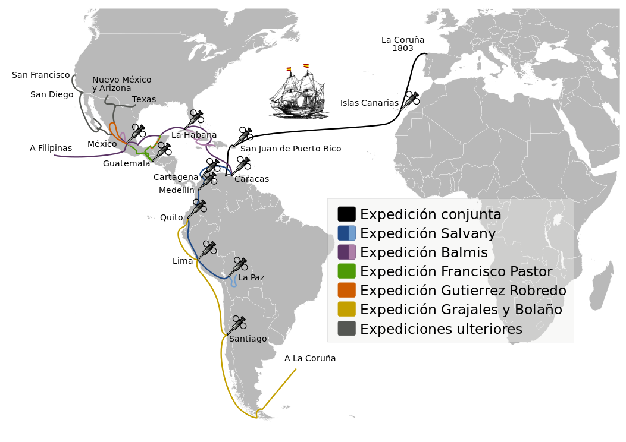

qUestion 1: Which disease was eradicated by the first global vaccination campaign?
C: Smallpox
Notes:
Answer C
https://en.wikipedia.org/wiki/Eradication_of_infectious_diseases#Smallpox
https://www.zeitsprung.fm/podcast/zs224/
https://en.wikipedia.org/wiki/Balmis_Expedition

Slide 38
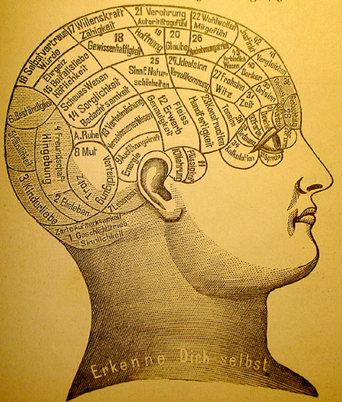
qUestion 2: How many heads are in the grave of the famous musician Joseph Haydn?
2 Heads
Notes:
Answer: 2
https://www.zeitsprung.fm/podcast/zs217/
https://en.wikipedia.org/wiki/Haydn%27s_head
https://en.wikipedia.org/wiki/Joseph_Haydn

Slide 39
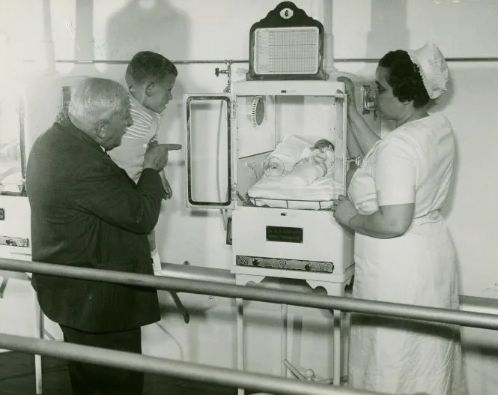
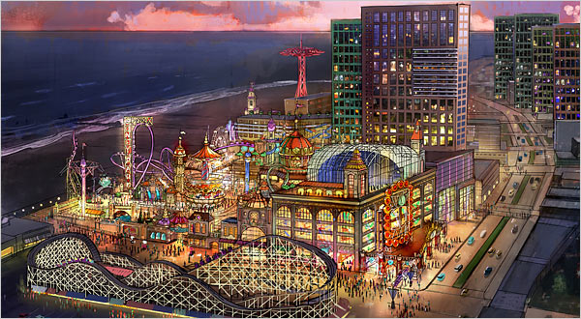
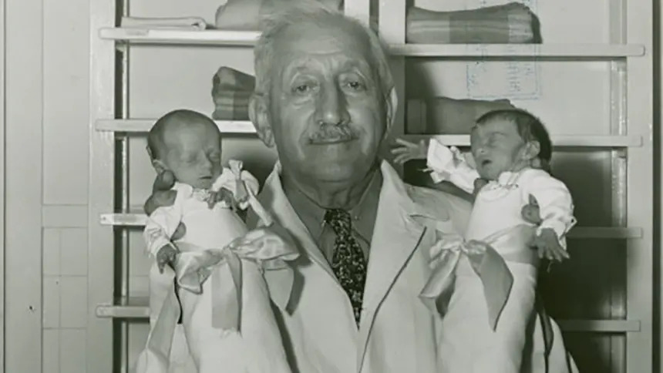
qUestion 3: How Was the usage of baby Incubators established in the U.S of America as a standard in hospitals?
C: Through a
human zoo of babies in incubators
6,500
Dr. Martin Couney
Notes:
Answer C
https://www.history.com/news/baby-incubators-boardwalk-sideshows-medical-marvels
https://www.zeitsprung.fm/podcast/zs188/
Between 6000 and 7000 babies were rescued through this

Slide 40

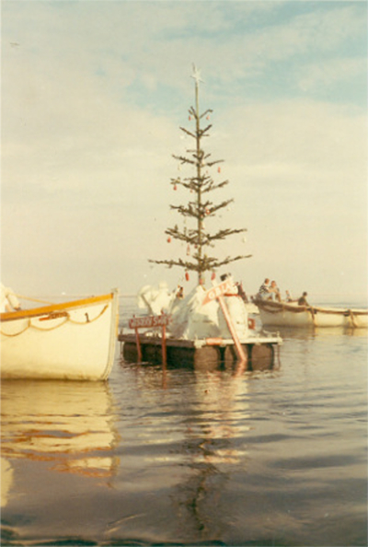

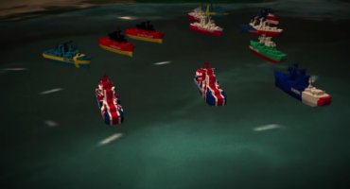
qUestion 4: What was the yellow fleet?
D: fifteen ships that were trapped in the Suez Canal
Notes:
Answer D
https://en.wikipedia.org/wiki/Yellow_Fleet

Slide 41
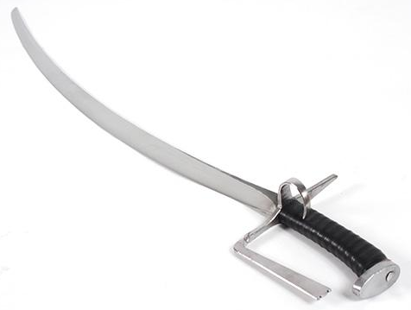
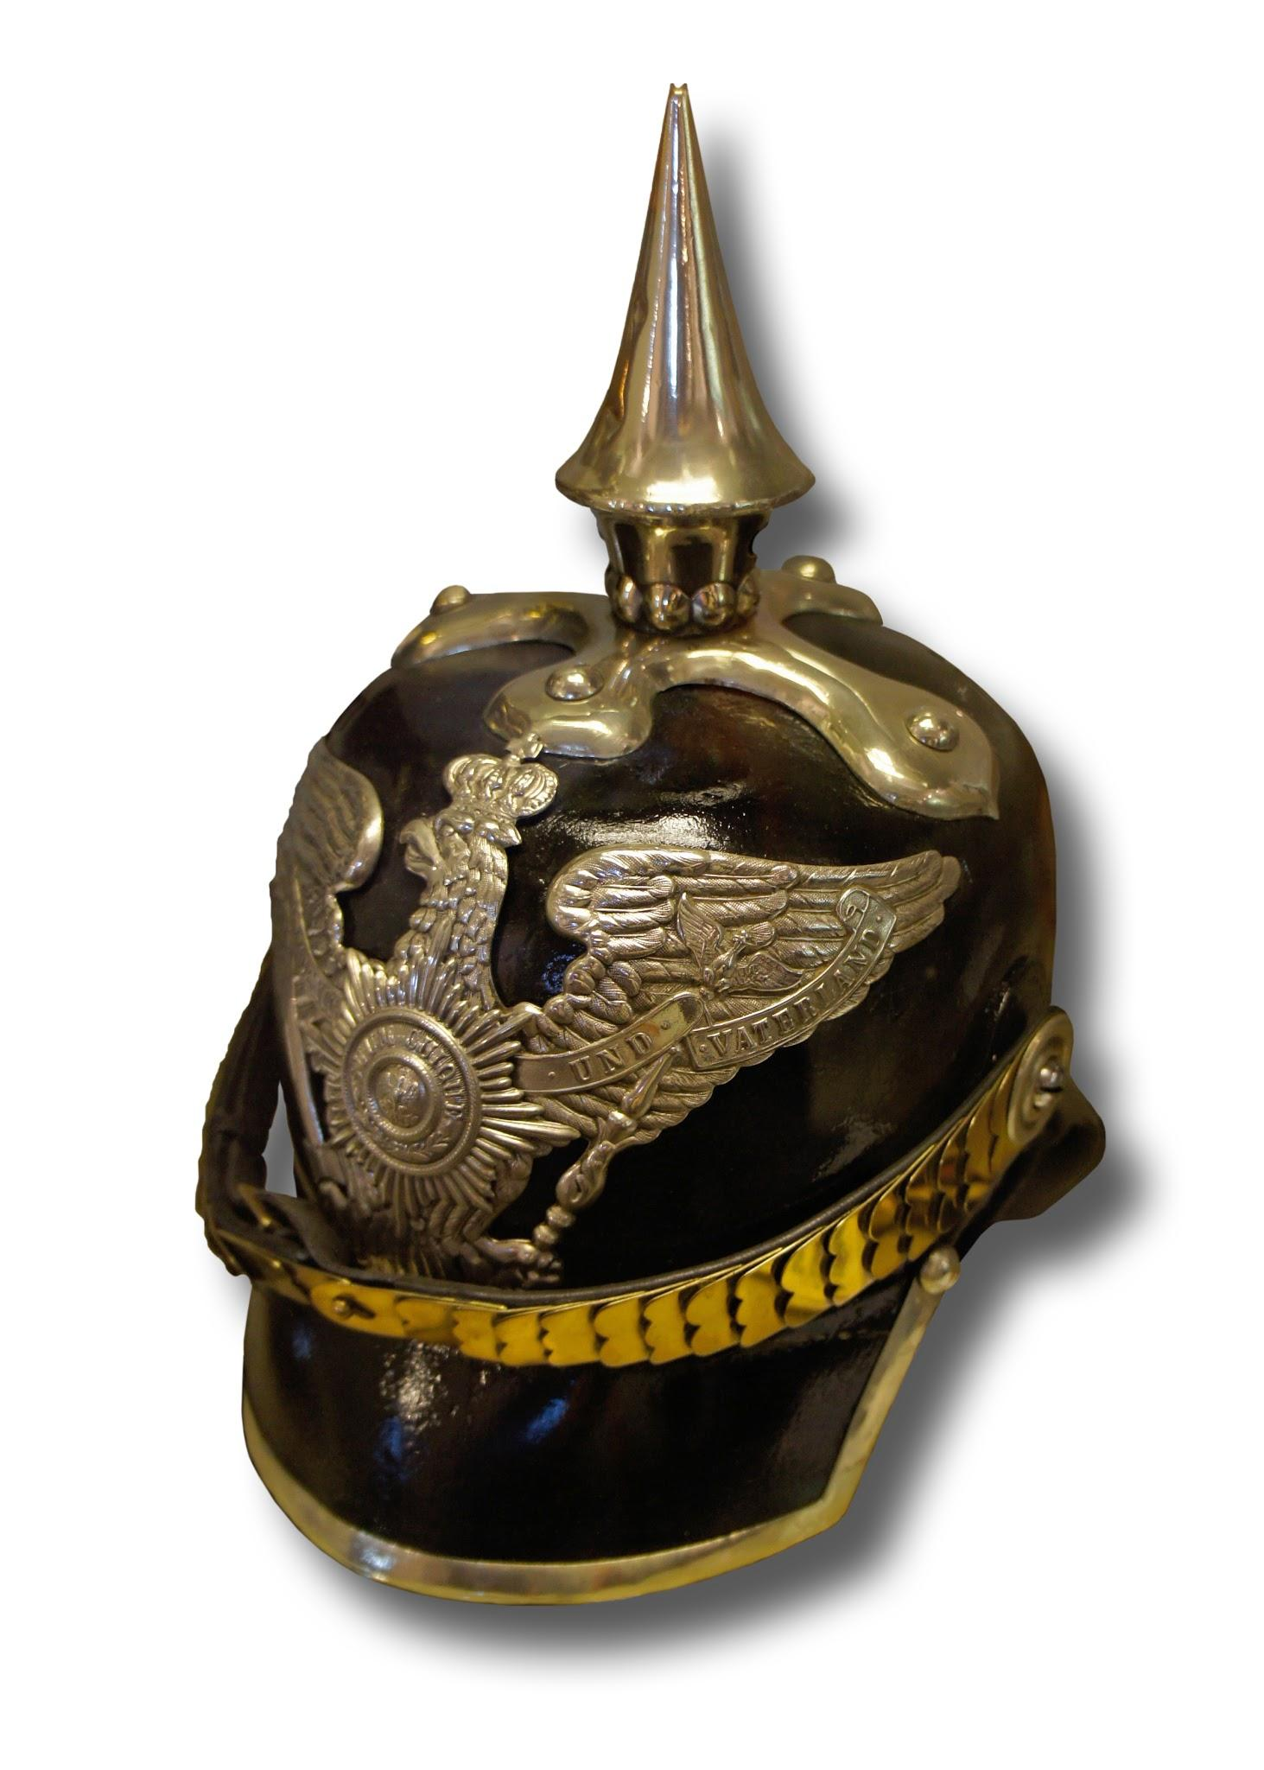
qUestion 5: what is this for?
Notes:
It is to defend against an attack of swords
https://en.wikipedia.org/wiki/Pickelhaube
https://www.youtube.com/watch?v=WbGOQtfjQFo

Slide 42

Now we Wait For the Winners

Slide 43
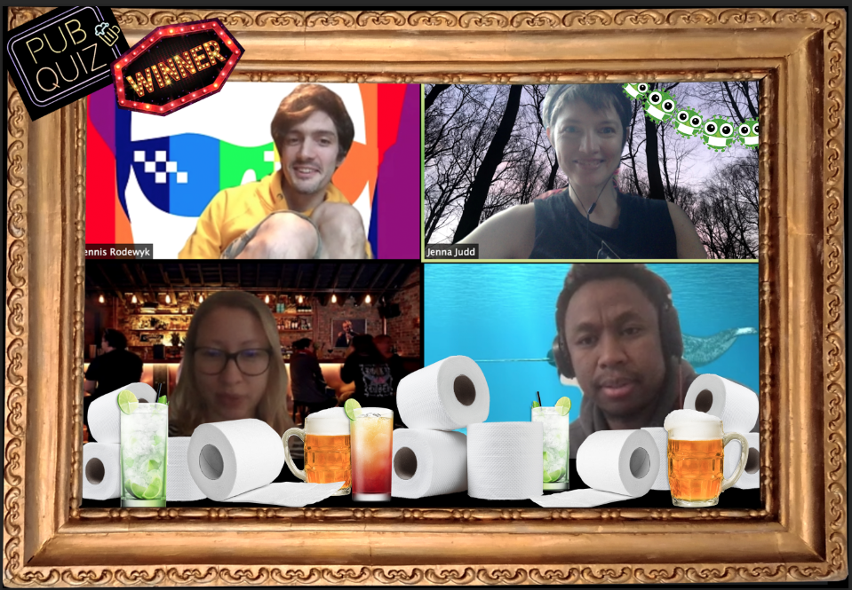
The Winners are
Maybe LAter
35.25 out of 53.75 Points
Notes:
TODO: virtual toilet paper, funny picture, voucher to go outside

Slide 44

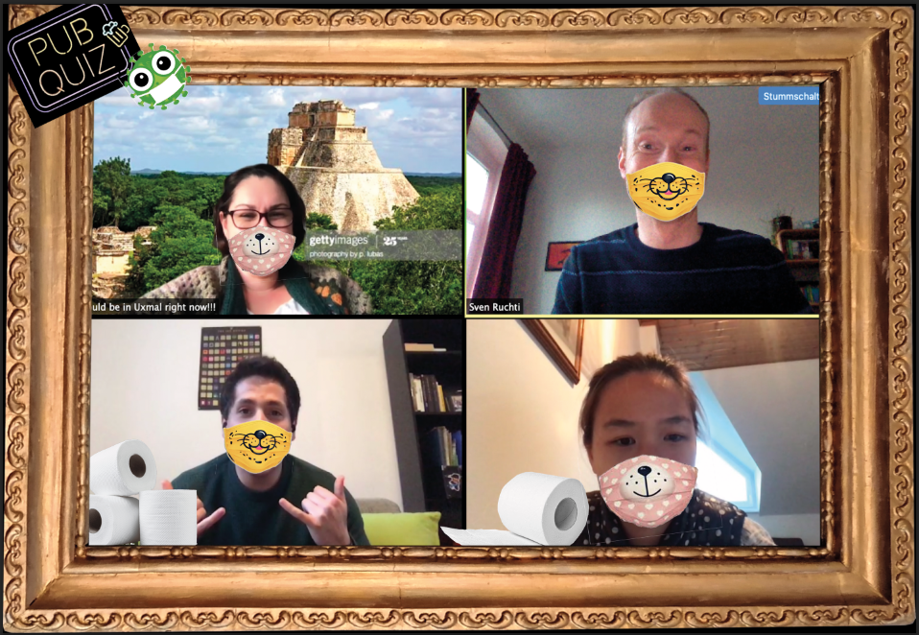
The 2nd Winners are:
Na ZDRowie
Too much pressure
33.75 out of 53.75 Points
33.5 out of 53.75 Points

Slide 45
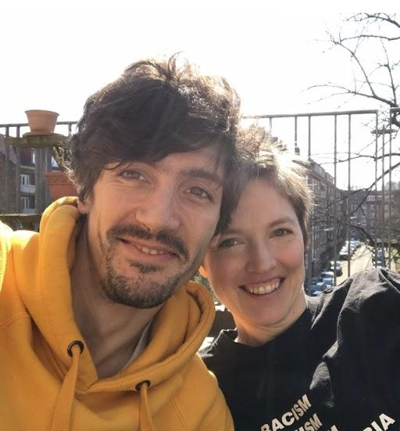
AND SPeCIAL CONGRATULATIONS
TO JENNA AND DENNIS!
HAPPY Anniversary!
Notes:
TODO: virtual toilet paper, funny picture, voucher to go outside

Slide 46
Thank YOU for joIning!

